Slide 1
Libav
報告: 周以恆

Slide 2
Outline
01
02
03
04
Libav
Video File Formats
What is Libav?
Video? Audio? Codec? Container?
Build
Play with Libav
Hands on! Build and
create library files.
0_hello_world.c
1

Slide 3
01
Libav
So what is this?
?
?
2

Slide 4
History
We want a better API.
Too many Bugs!!
Suspended
FF
(Fast Forward)
+
=
2000
2011
We want to support more features.
2015
2021
3

Slide 5
Libraries
Main Libraries
Libavutil
Libavcodec
Libavforamt
libavdevice
Libavfilter
Containing functions for simplifying programming.
Containing decoders and encoders for audio/video codecs.
Containing demuxers and muxers for multimedia container formats.
containing multimedia input/output software frameworks.
containing media filters.
Libswscale
Libswresample
Performing highly optimized image scaling and color space/pixel format conversion operations.
library performing highly optimized audio resampling, rematrixing and sample format conversion operations
4

Slide 6
Tools
Who use them?
5

Slide 7
02
Video File Formats
Video? Audio? Codec? Container?
6

Slide 8
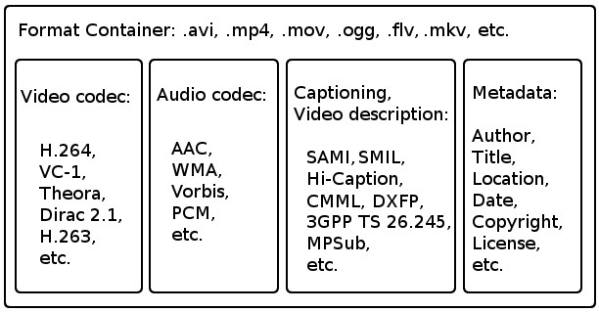
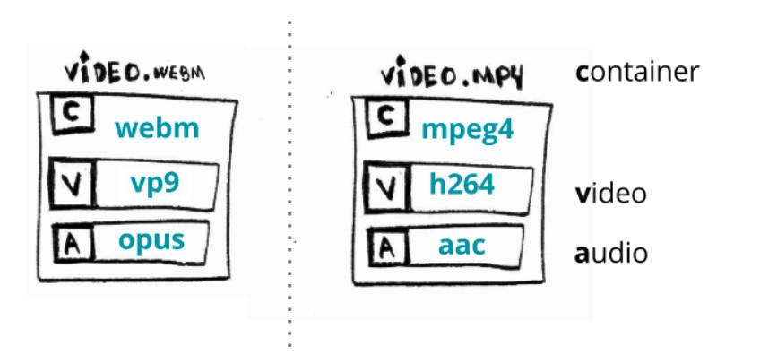
Container
Just like a box.
每個 Container 支援的 Codec 不盡相同，所以不是每種 Codec 都可以混用!
最常見的組合就是 H.264 + AAC
Video Containers and Codecs
7

Slide 9
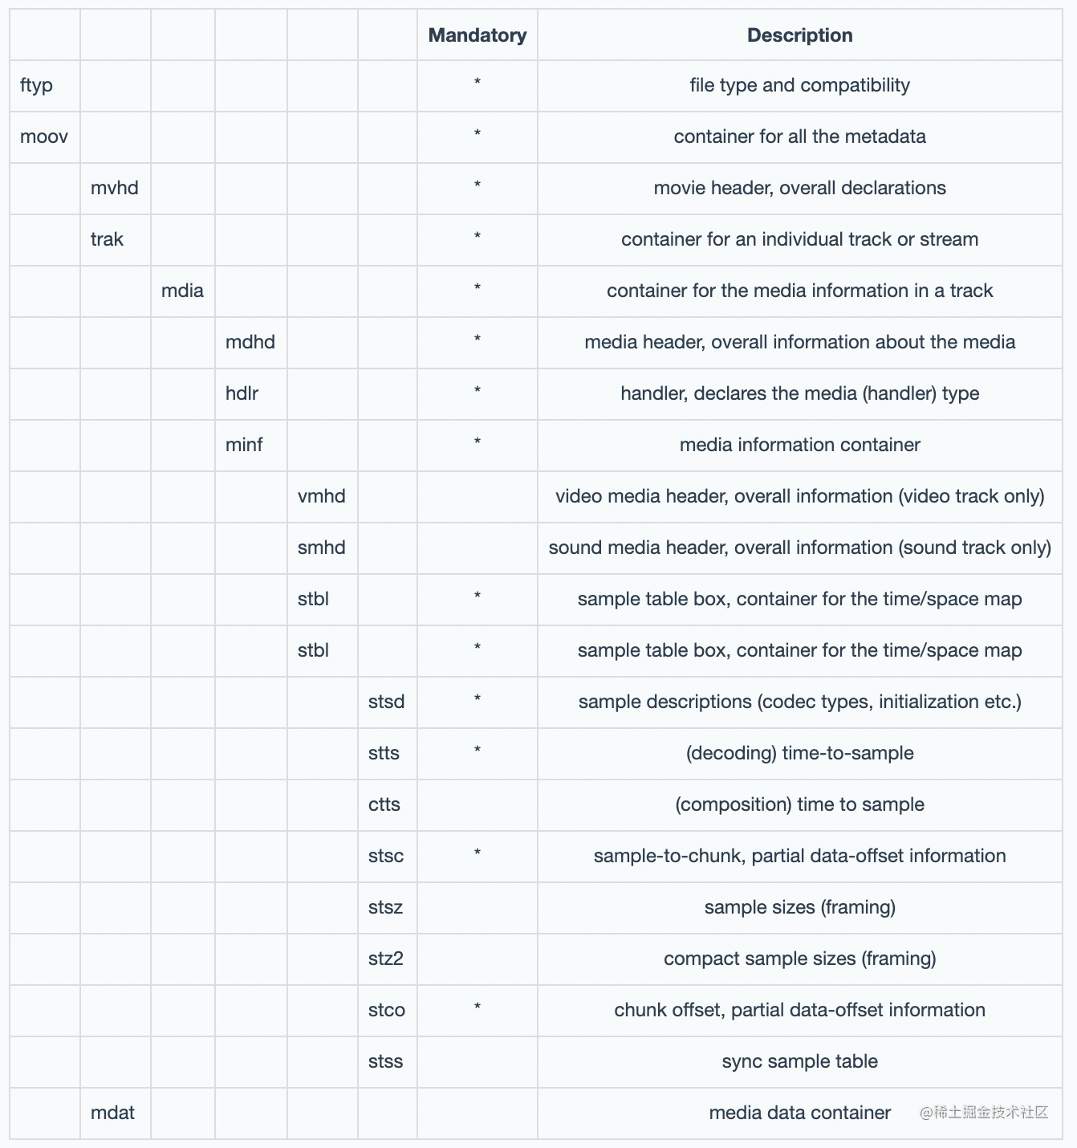
Box
Boxes in Boxes in…
以 MPEG-4 part 14 (MP4)為例每個 Container
裡會有很多個不同的 Boxes 每個 Box 裡面也可
以有更多 Boxes.
最常見的幾個 Box:
ftyp (File Type Box): 標記 Mpeg 的不同 Standard mp41、mp42。
moov (Movie Box): 存有影片內容的訊息，影片時長，播放速率和解析度等等。
mdat (Media Data Box): 放實際的影片資料。
Many types of boxes.
8

Slide 10
Codec
Compression Technique of h.264
I‑frames: are the least compressible but don't require other video frames to decode.
P‑frames: can use data from previous frames to decompress and are more compressible than I‑frames.
B‑frames: can use both previous and forward frames for data reference to get the highest amount of data compression.
I, B and P-frame
9

Slide 11
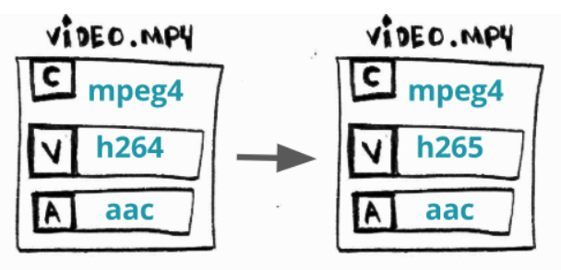
Operations
1. Transcoding
根據播放裝置，換成更適合或是有支援的 Codec 。
像是 Netflix 就會根據觀看的裝置來使用不同的 Codec 組合。
10

Slide 12
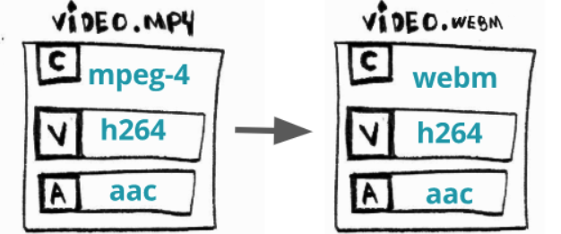
Operation
2. Transmuxing
11

Slide 13
03
Hands On
12

Slide 14
Commands
Configure
./configure --disable-asm --enable-avdevice --enable-doc --disable-programs --disable-shared --enable-static --disable-bzlib --enable-gray --disable-libopenjpeg --disable-iconv --disable-zlib --prefix=./vs2019_build --toolchain=msvc --arch=x86 --extra-cflags=-MDd --extra-ldflags="/NODEFAULTLIB:libcmt" --enable-debug
Make
make –j8
13

Slide 15
04
Play with Libav
14

Slide 16
Link Libav in Visual Studio
Hackmd
https://hackmd.io/@Henry-Zhou/Byc0GT-HF
15

Slide 17
Reference
Learn FFmpeg in a hard way
用vs2017編譯ffmpeg 4.0.3詳細過程，並可調試

