Slide 1
A LoRa Wireless Mesh Networking Module for Campus-Scale Monitoring
Kai-Hsiang Ke, Qi-Wen Liang, Guan-Heng Chen, Guan-Jie Zeng, Kai-Lin Cheng, Chia-Min Su, Jun-Han Lin, Huang-Chen Lee*
National Chung-Cheng University
16th ACM/IEEE International Conference on Information Processing in Sensor Networks, Pittsburgh, Pennsylvania USA, April 2017
Presenter:Jonathan

Slide 2
Outline
What’s LoRa?
LoRaWAN Architecture
Preliminary Design
Package Delivery Ratio (PDR) Results
Conclusion
My Research Ideas
Problem definition, and the importance of this problem.
Survey of previous solutions, and why you want to propose a new solution.
Architecture of your system
Performance measurement
Conclusions and future work

Slide 3
What’s LoRa
LoRa® (Long Range) is the wireless modulation to create the long range communication.
LoRaWAN use Unlicensed Band
LoRa network advantages:
Long range
Low power Consumption

Slide 4
Star Topology
Gateway
Endnode

Slide 5
Mesh Topology
Advantage
Increase the range
Disadvantage
Add complexity
Reduce Battery lifetime

Slide 6
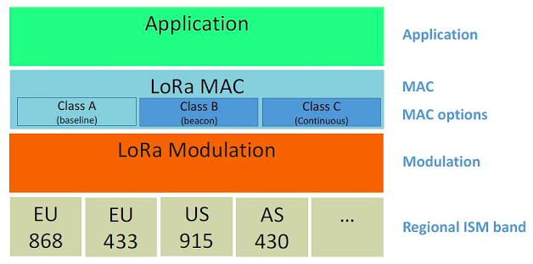
LoRaWAN Architecture

Slide 7
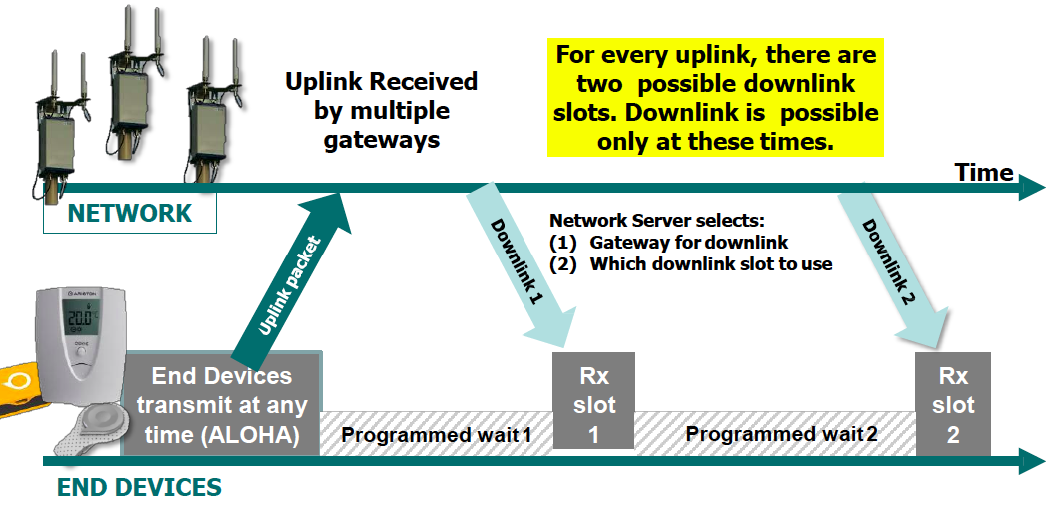
Class A

Slide 8
Class B

Slide 9
Preliminary Design
Gateway will broadcast beacons to invite other LoRa nodes to join the network.
LoRa nodes set the gateway as its network parent.
Gateway may query data from his children LoRa nodes, and the data messages reported from the LoRa node will act as a beacon for other nearby nodes .

Slide 10
Node 1 has joined the network and set the Gateway as its parent.
Gateway query Node 1.
Node 3 overhears the message M2 and joins the network by setting its parent as Node 1.

Slide 11
Gateway query Node 3 by using message M3, M4, M5 and M6.
Based on this method, the gateway can query data on all the nodes.

Slide 12
M6
M5

Slide 13
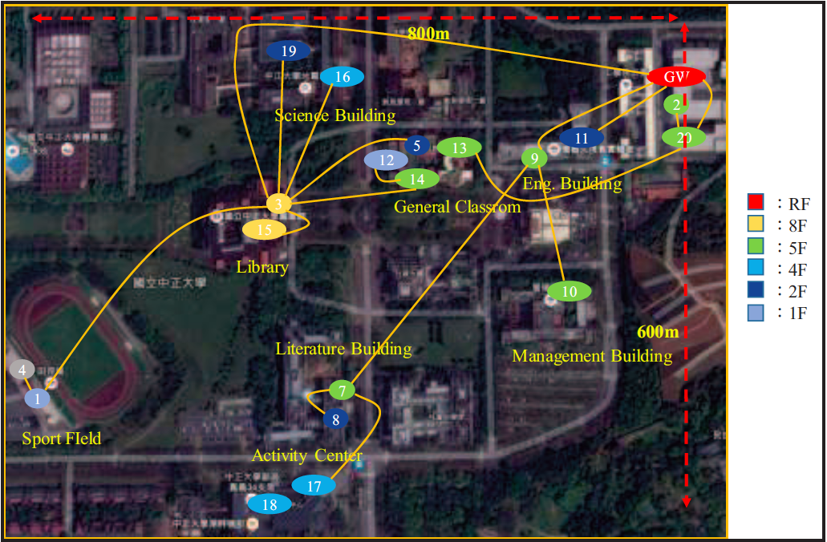
Network Topology snapshot

Slide 14
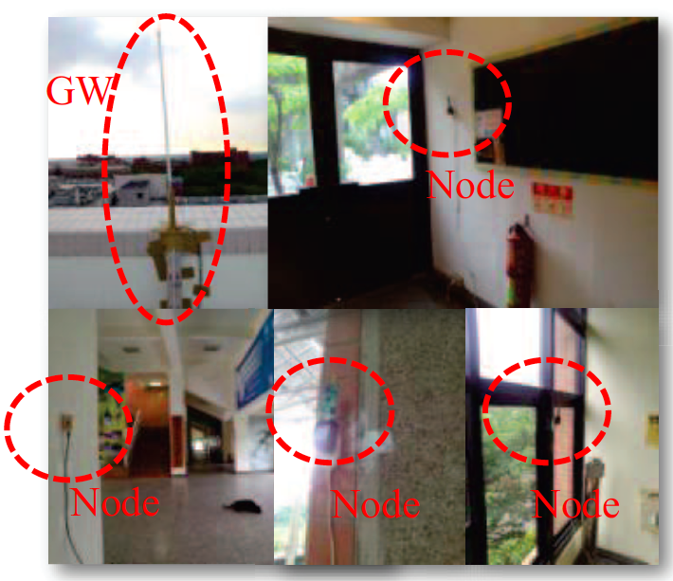
GW and Node deploy in experiment

Slide 15
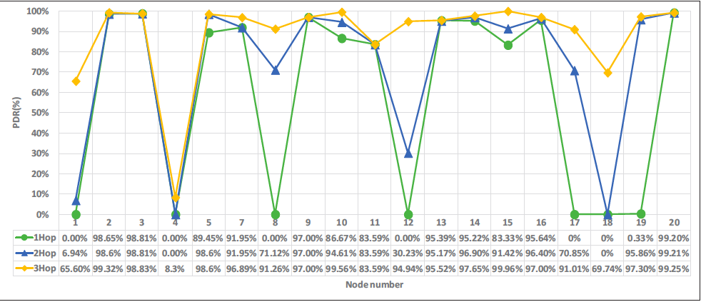
Package Delivery Ratio(PDR) Results
1 Hop indicates node can only connect to GW with one hop.

Slide 16
Package Delivery Ratio(PDR) Results
1 hop indicates node can connect to the GW with one hop, which can be considered as star-topology.
For example, PDR of Node 12 at 1 hop is 0%, 30.23% at 2 hops and 94.94% at 3 hops.
The average PDR of all devices for 1 hop is 58.7% and 3 hops is 88.49%.

Slide 17
Conclusion
This experiment demonstrates that proposed solution can significantly increase PDR without deploying an additional gateway.
AODV(ad-hoc on-demand distance vector) Routing Protocol
Notes:
1.Routing protocol is not sure
2. AODV (ad-hoc on-demand distance vector)

Slide 18
My Research Ideas
Problem definition, and the importance of this problem.
Survey of previous solutions, and why you want to propose a new solution.
Architecture of your system.
Performance measurement.
Conclusions and future work.

Slide 19
Problem definition
The indoor LoRa devices may not to communicate with a nearby gateway.
Physical obstacles can attenuate wireless signal strength and result in data losses.
In the future, many LoRa devices will install indoor. If LoRa signal strength is not good and data losses very often, and devices are not very practical.

Slide 20
My Research Ideas
Problem definition, and the importance of this problem.
Survey of previous solutions, and why you want to propose a new solution.
Architecture of your system.
Performance measurement.
Conclusions and future work.

Slide 21
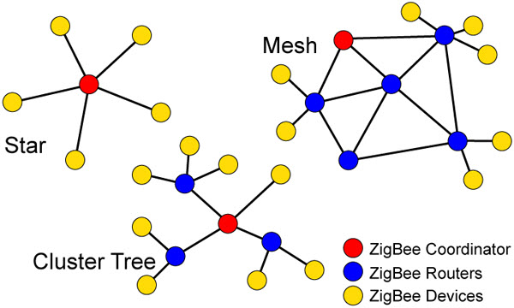
Survey of previous solutions
Today’s presentation is survey of previous solutions.
It is new problem so there are not many solutions to reference.
Why node can use at most 3 hops to deliver data to gateway?
I try to use Cluster Tree to implement
LoRa Cluster Tree network, this maybe can
improve some LoRa devices’ power
consumption.

Slide 22
My Research Ideas
Problem definition, and the importance of this problem.
Survey of previous solutions, and why you want to propose a new solution.
Architecture of your system.
Performance measurement.
Conclusions and future work.

Slide 23
Architecture of my system
Reference to Zigbee Cluster Tree network.
LoRa Gateway
LoRa Router
LoRa Enddevices

Slide 24
My Research Ideas
Problem definition, and the importance of this problem.
Survey of previous solutions, and why you want to propose a new solution.
Architecture of your system.
Performance measurement.
Conclusions and future work.

Slide 25
Performance measurement
PDR Result of Dearpartment of CSIE with 1 Hop

Slide 26
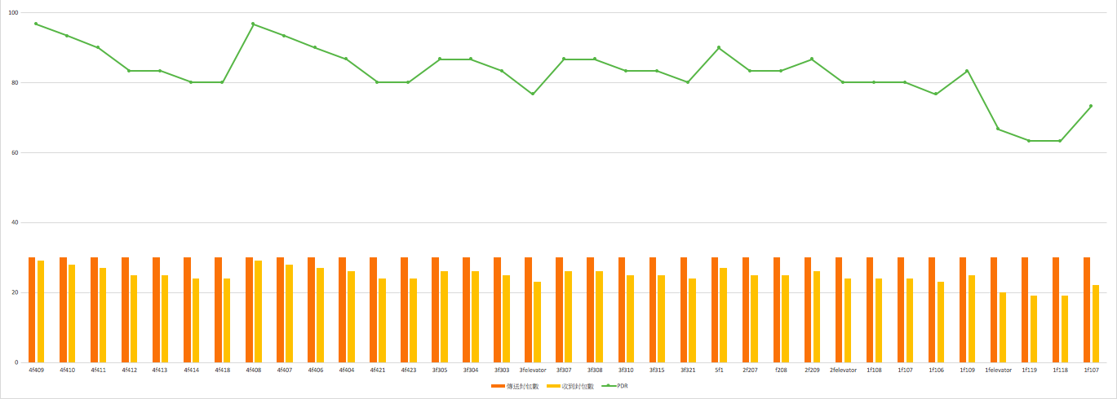
Performance measurement
PDR Result of Dearpartment of CSIE with 1 Hop

Slide 27
My Research Ideas
Problem definition, and the importance of this problem.
Survey of previous solutions, and why you want to propose a new solution.
Architecture of your system.
Performance measurement.
Conclusions and future work.

Slide 28
Conclusions and future work
I have to finish my experiment and measurement first.
My expect conclusion is LoRa cluster network not only increase communication range but also reduce some device power consumption in the same PDR.

Slide 29
Q & A

Slide 30
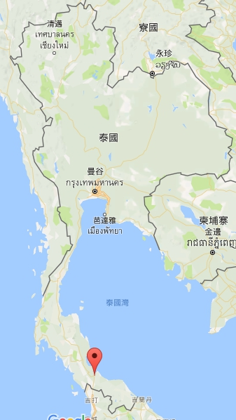
Hat Yai 合艾

Slide 31
Prof. Dr. Sinchai Kamolphiwong

Slide 32
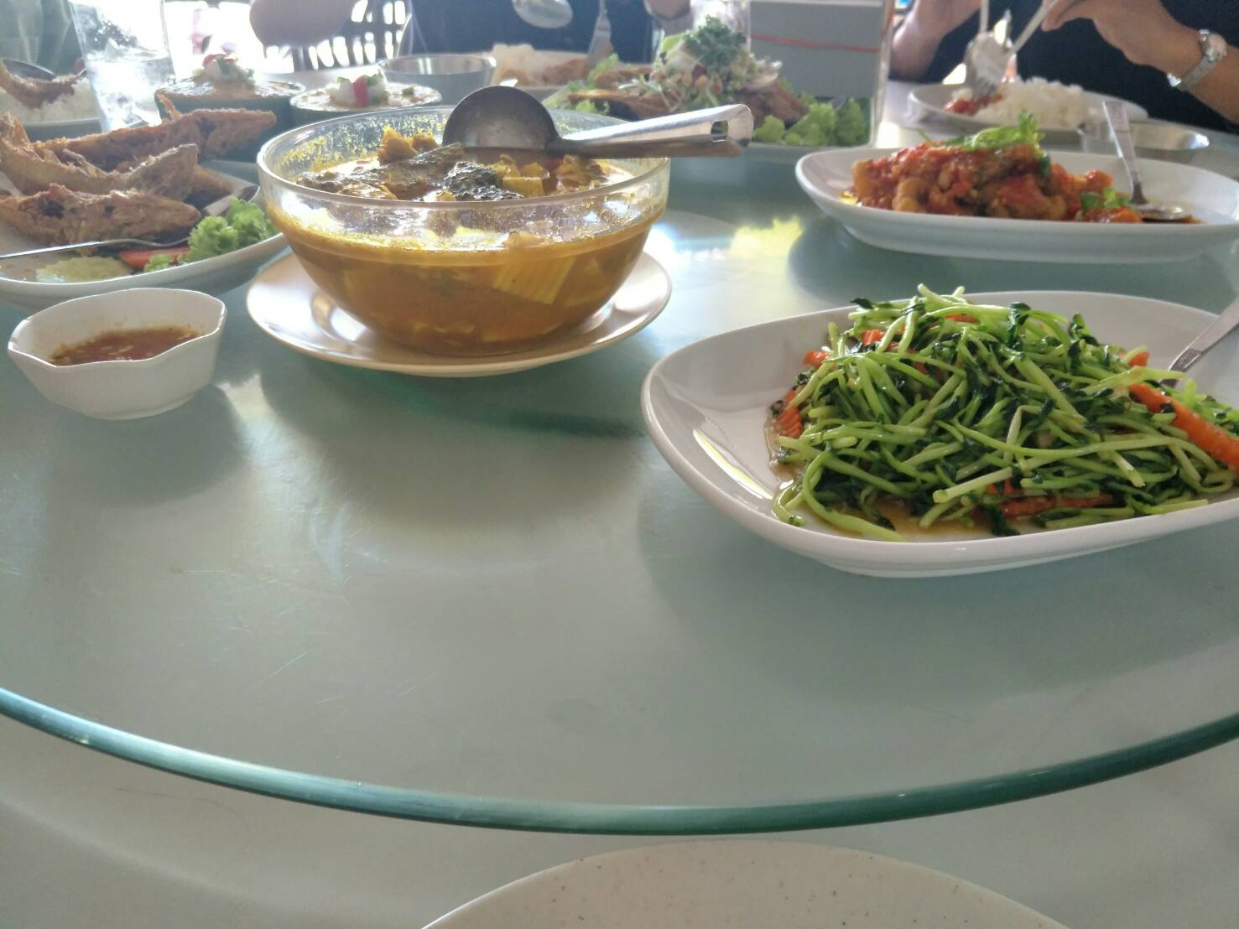
Day 1 道地泰式餐廳

Slide 33
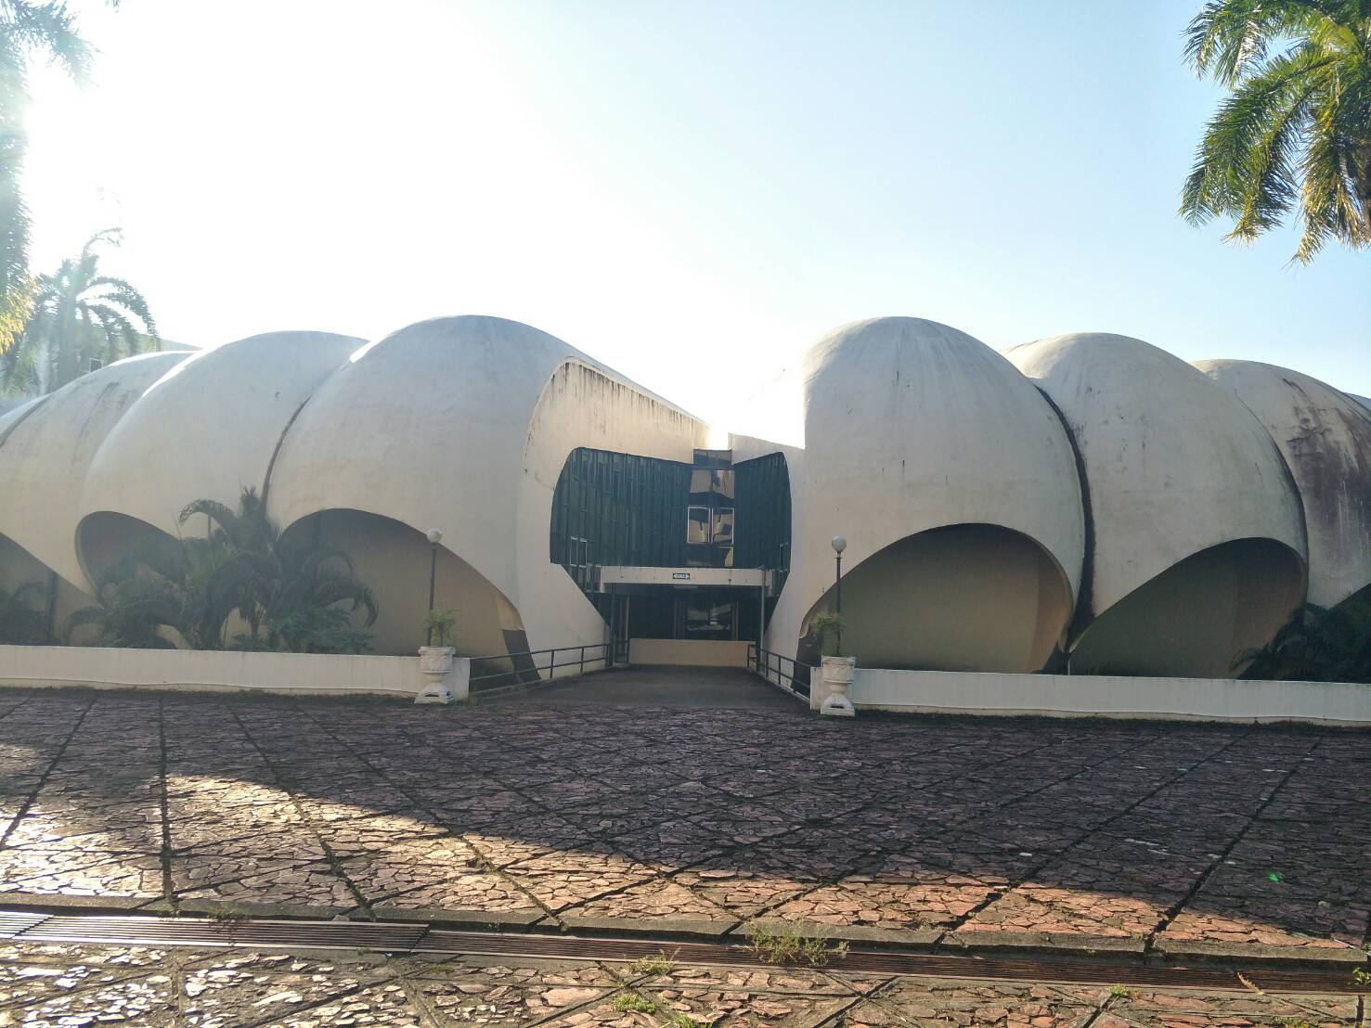
Day 1 PSU中空拍像南瓜的建築

Slide 34
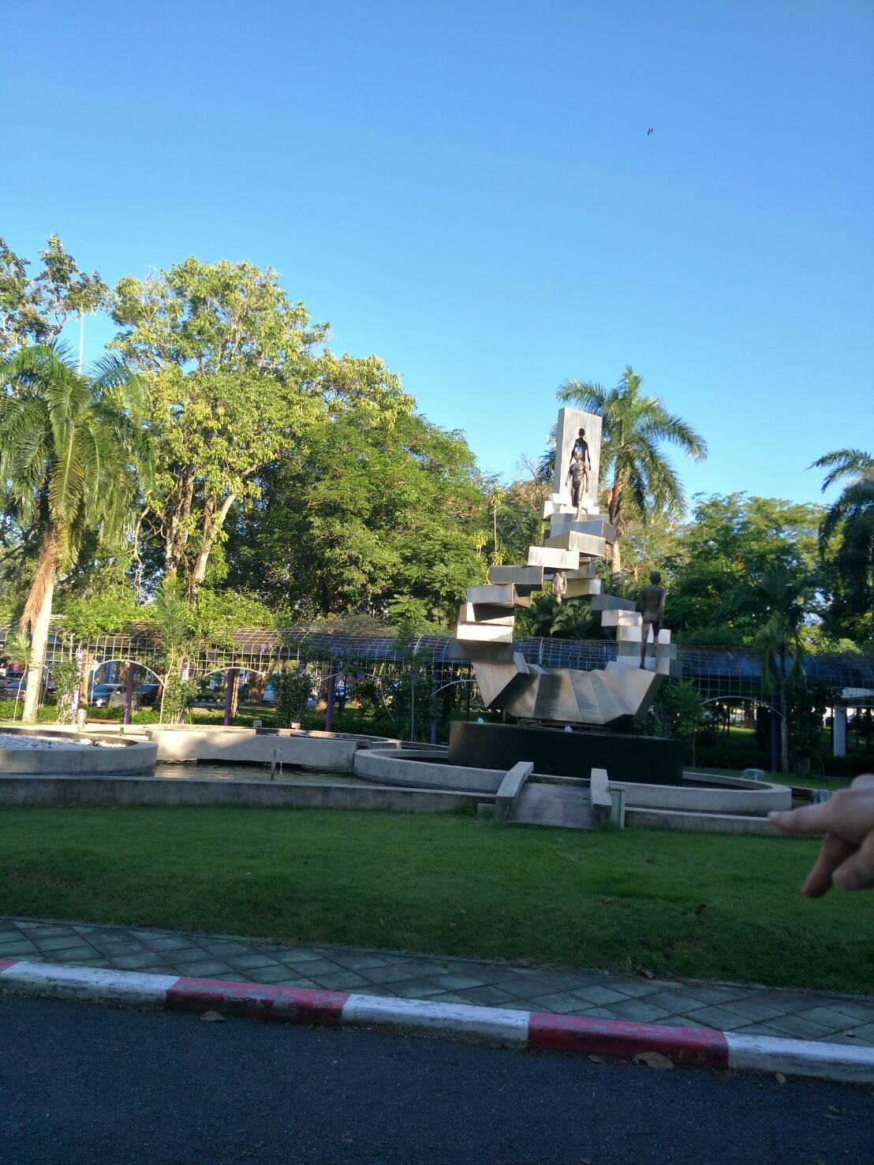
Day 2 有名的雕像

Slide 35
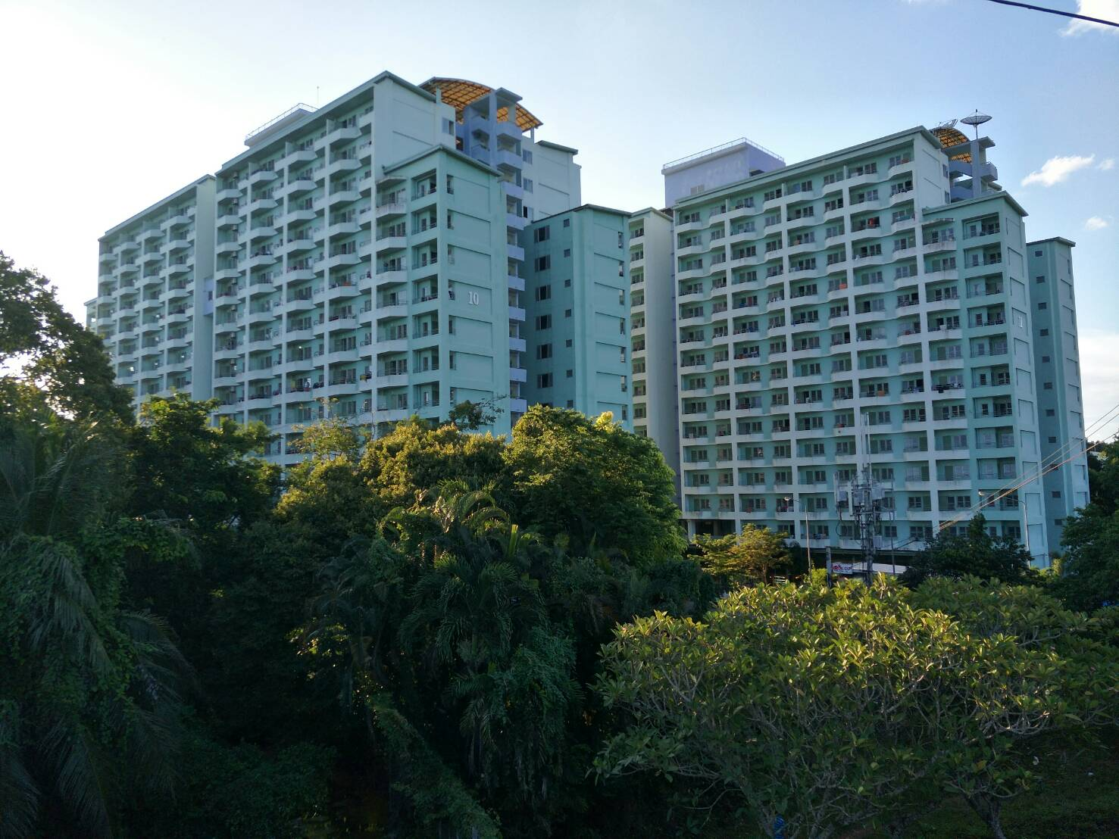
Day 2 PSU的學生宿舍

Slide 36
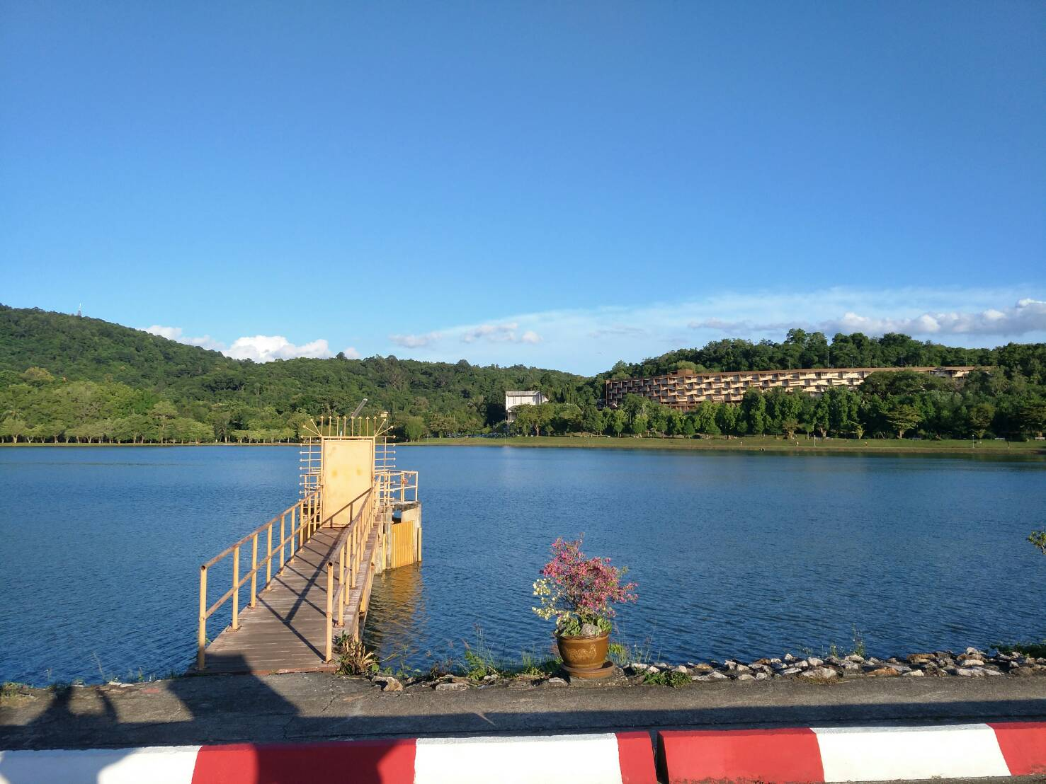
Day 2 PSU裡的湖

Slide 37
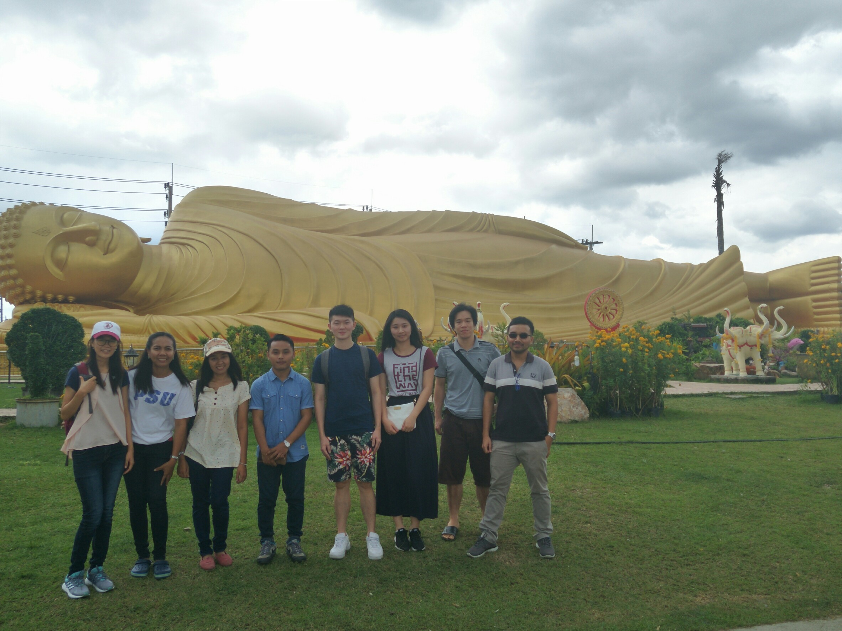
Day 2 宋卡府--臥佛寺

Slide 38
Day 2 大佛山上看夕陽＆合艾市區
紅色圈圈裡是PSU

Slide 39
泰式麥當勞叔叔

Slide 40
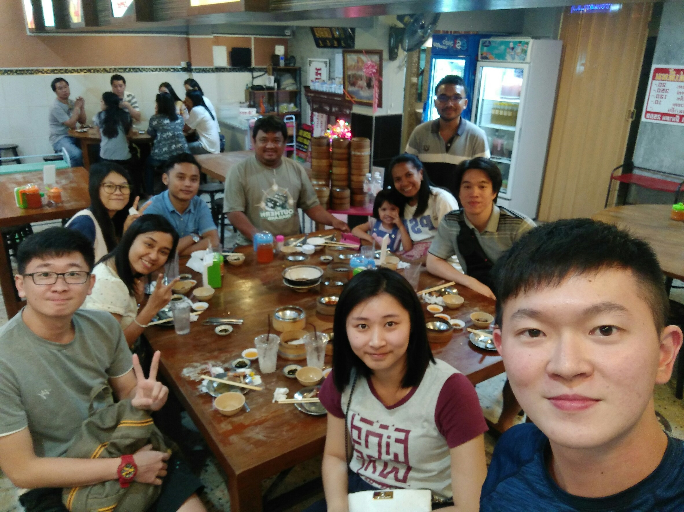
Day 2 晚餐吃泰國很有名的Dim Sum＆肉骨茶

Slide 41
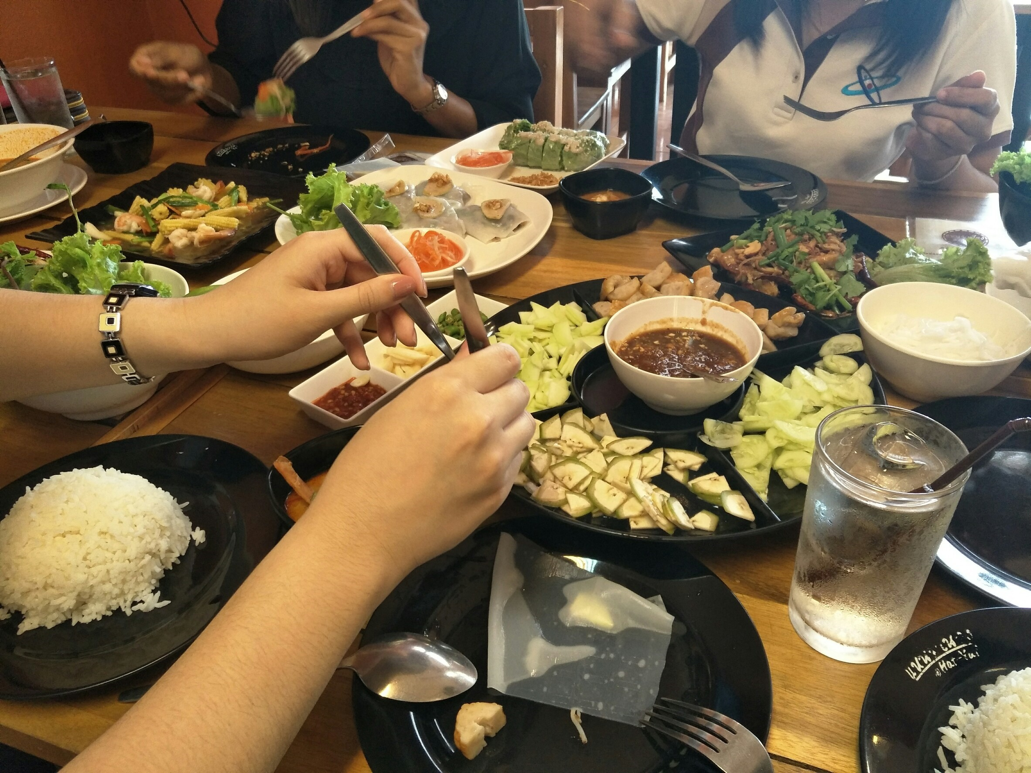
Day 3 中午吃了很特別的泰北菜

