Slide 1
Request for Comments(RFC) 3489
STUN - Simple Traversal of User Datagram Protocol (UDP)
Through Network Address Translators (NATs)
江俊杰
1

Slide 2
Outline
NAT four type
Full Cone NAT
Restricted Cone NAT
Port Restricted Cone NAT
Symmetric NAT
What is STUN ?
Testing NATs with STUN Algorithm
Conclusion
2

Slide 3
Full Cone NAT
A full cone NAT is one where all requests from the same internal IP address and port are mapped to the same external IP address and port
3

Slide 4
Full Cone NAT
4

Slide 5
Full Cone NAT
5

Slide 6
Restricted Cone NAT
Sent from the destination IP address inside the packet will be remembered, Only those who receive these packets into the NAT address can send packets, Sent here by other incoming packets, will be block.
6

Slide 7
Restricted Cone NAT
7

Slide 8
Restricted Cone NAT
8

Slide 9
Port Restricted Cone NAT
Restricted Cone A port restricted cone NAT is like a restricted cone NAT, but the restriction includes port numbers, An external host can send a packet, with source IP address X and source port P To the internal host only if the internal host had previously sent a packet to IP address X and port P.
9

Slide 10
Port Restricted Cone NAT
10

Slide 11
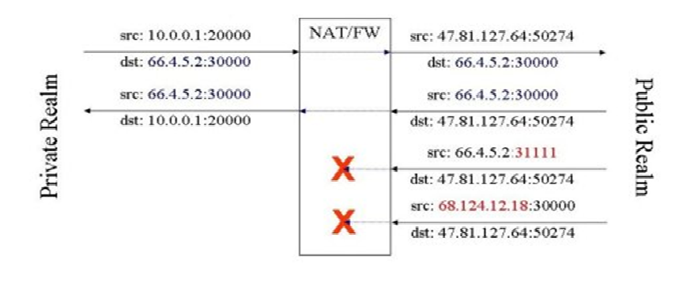
Port Restricted Cone NAT
11

Slide 12
Symmetric NAT
A symmetric NAT is one where all requests from the same internal IP address and port.
To a specific destination IP address and port, are mapped to the same external IP address and port.
If the same host sends a packet with the same source address and port, but to a different destination, a different mapping is used.
12

Slide 13
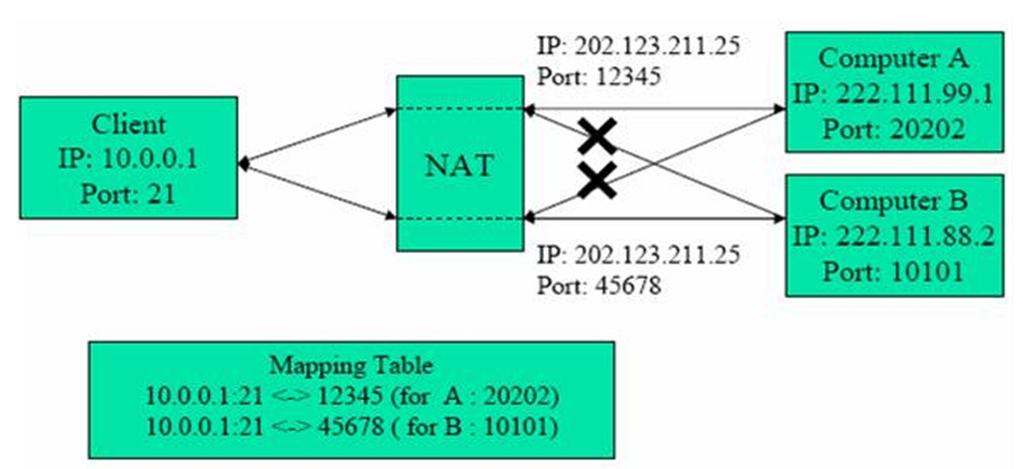
Symmetric NAT
13

Slide 14
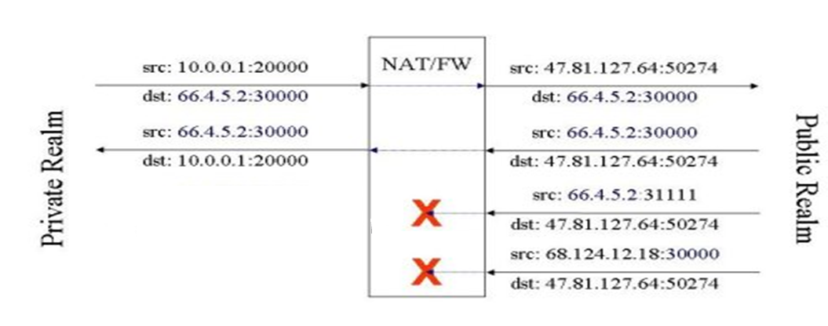
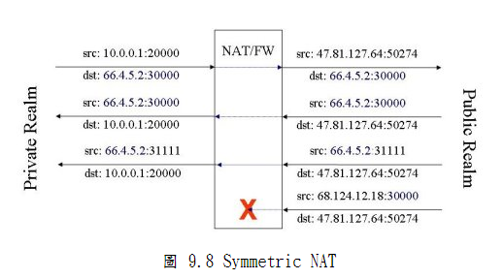
Symmetric NAT
14

Slide 15
What is STUN ?
This protocol is not a cure-all for the problems associated with NAT. It does not enable incoming TCP connections through NAT.
It allows incoming UDP packets through NAT, but only through a subset of existing NAT types.
15

Slide 16
STUN
16

Slide 17
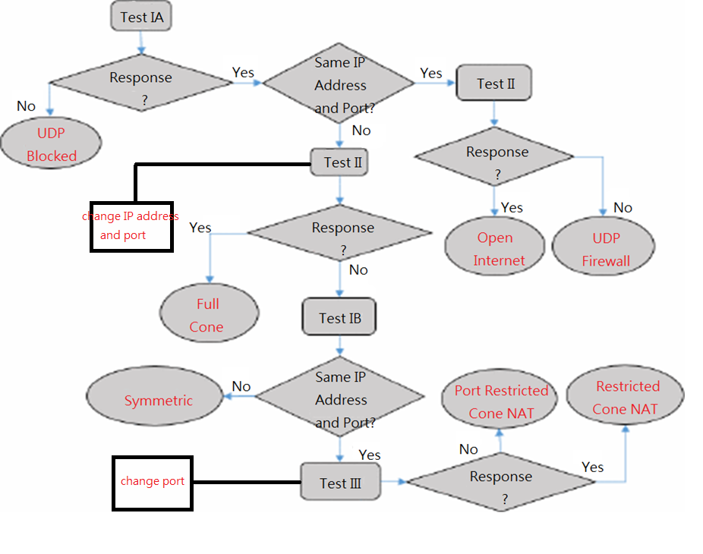
Testing NATs with STUN Algorithm
17

Slide 18
Testing NATs with STUN Algorithm
18

Slide 19
Conclusion
Determining the type of NAT is important in many cases. Depending on what the application wants to do, it may need to take the particular behavior into account.
19

