Slide 1
OpenFlow: A Security Analysis
Proceedings of the 21st IEEE International Conference on Network Protocols (ICNP), At Göttingen, Germany
Rowan Kloti, ETH Zurich Zurich, Switzerland
Vasileios Kotronis, ETH Zurich Zurich, Switzerland
Paul Smith, AIT Austrian Institute of Technology, 2444 Seibersdorf, Austria

Slide 2
Outline
Introduction about OpenFlow
Motivation
Security Analysis
  Attack Model
  STRIDE
  Attack Tree
Testing Result
  Denial of Service
  Information Disclosure
Conclusion
Reference

Slide 3
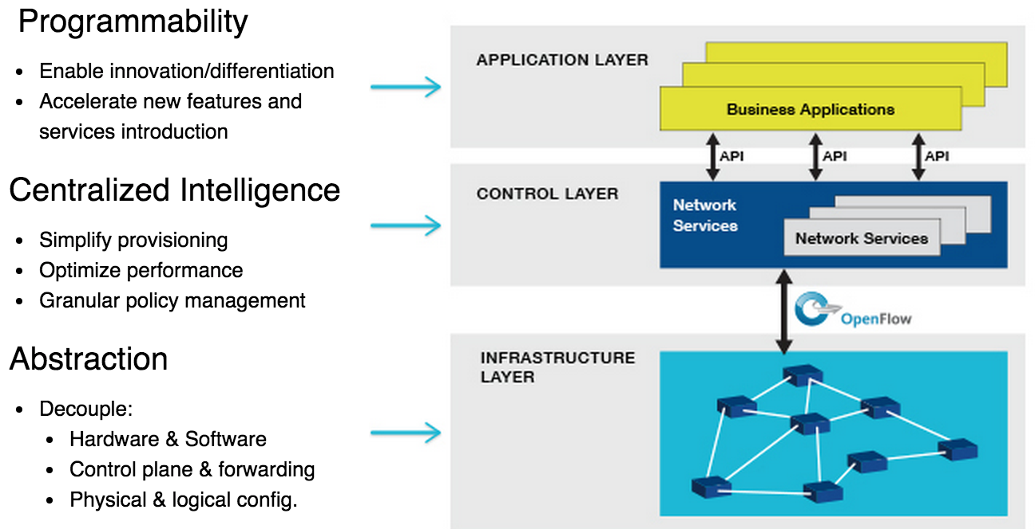
Introduction about OpenFlow

Slide 4
  Motivation
No official security analysis of the protocol itself
Security is extremely important for production systems, but can be overlooked

Slide 5
Security Analysis
Attack Model
STRIDE
Attack Tree

Slide 6
Attack Model
The attacker controls a single client
The attacker controls multiple clients
The attacker has access to control network

Slide 7
STRIDE
Spoofing Identity
Tampering with data
Repudiation
Information Disclosure
Denial of Service
Elevation of Privilege

Slide 8
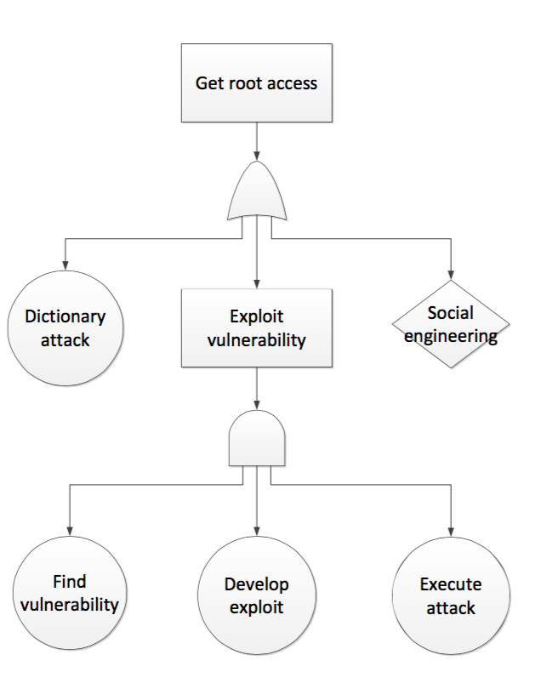
Attack Tree
Use to describe and analysis the attacks

Slide 9
Testing Results
Denial of Service
Information Disclosure

Slide 10
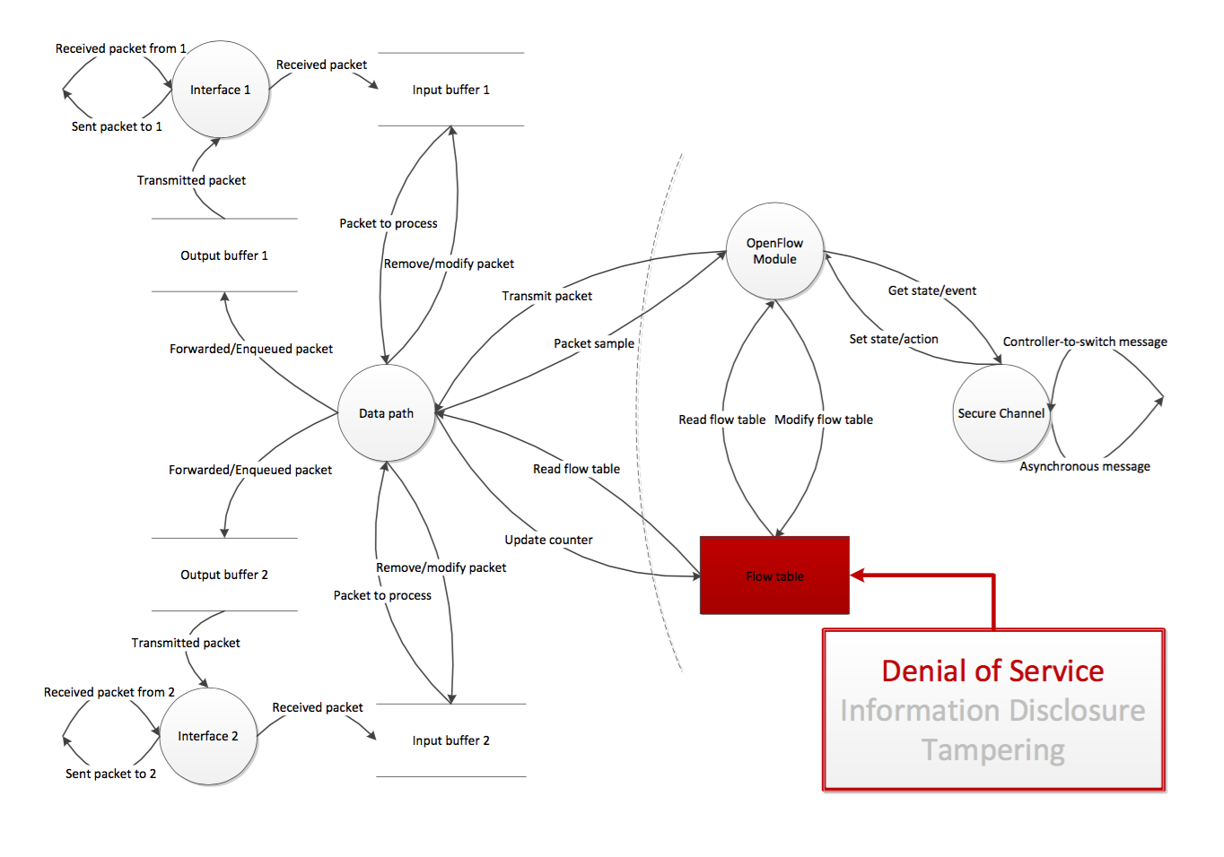
Denial of Service

Slide 11
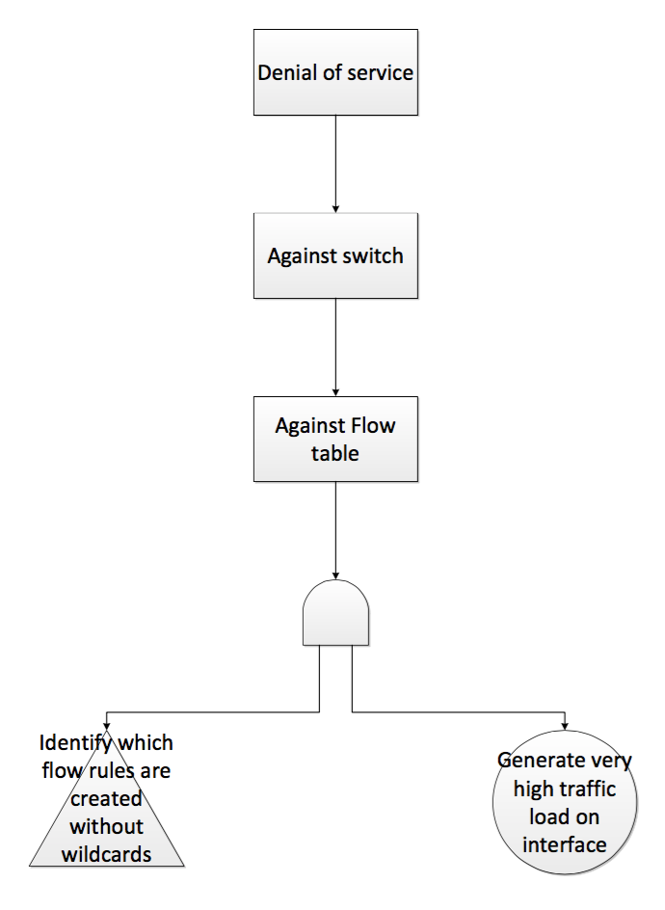
Denial of Service

Slide 12
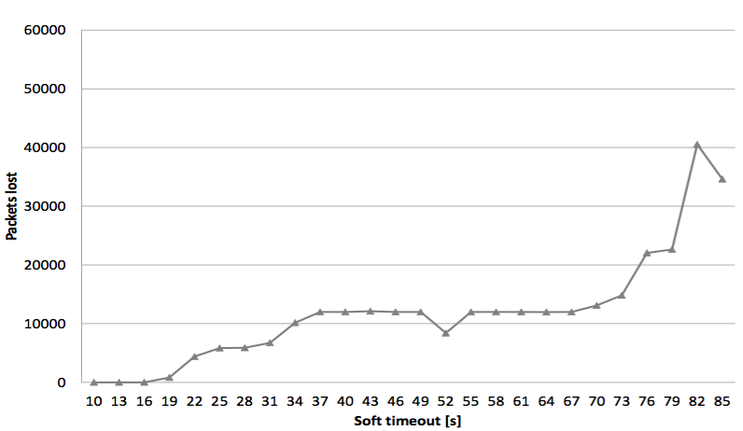
Denial of Service

Slide 13
Denial of Service
Using Estinet to simulate both DoS attack between traditional and SDN

Slide 14
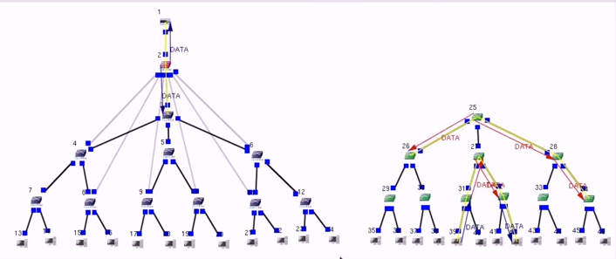
Denial of Service

Slide 15
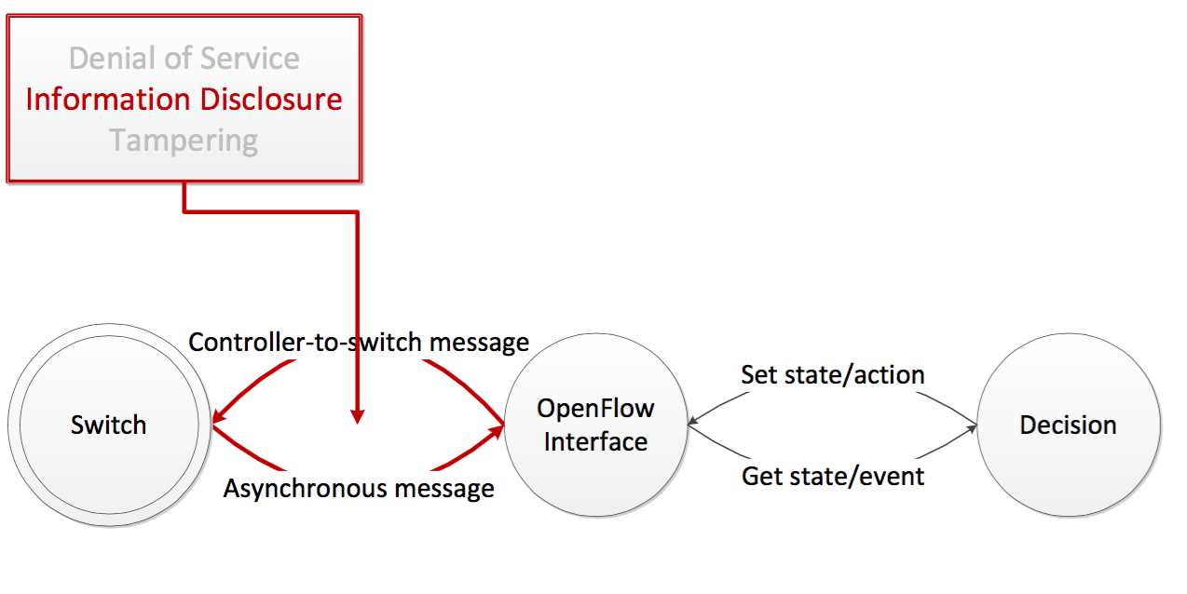
Information Disclosure

Slide 16
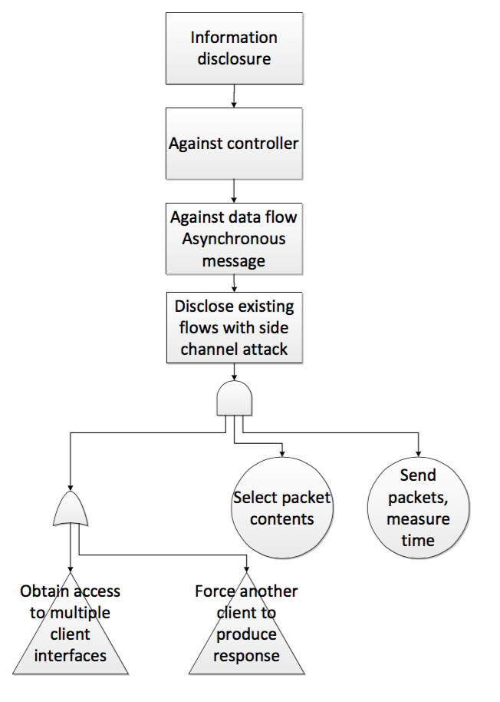
Information Disclosure

Slide 17
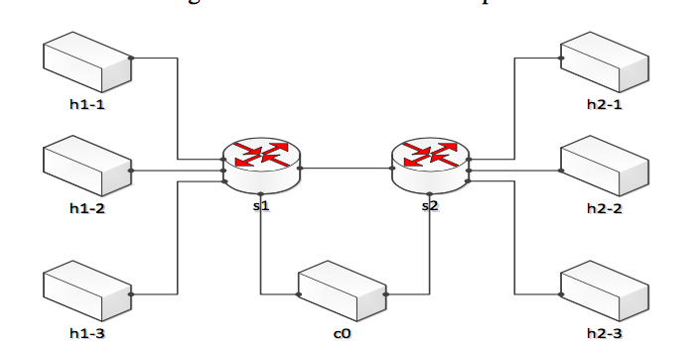
Information Disclosure

Slide 18
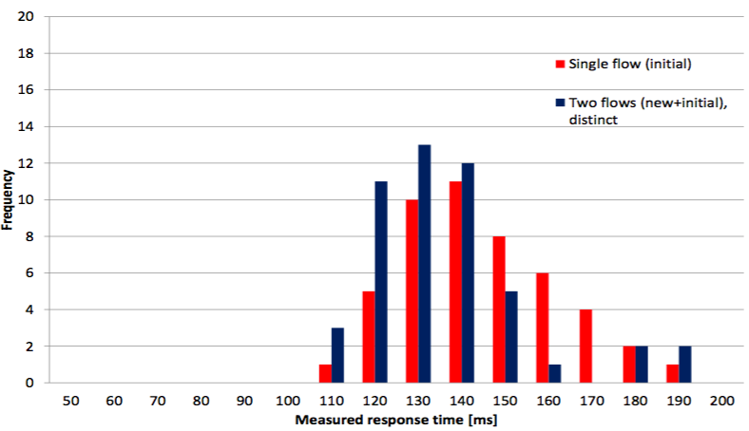
Information Disclosure

Slide 19
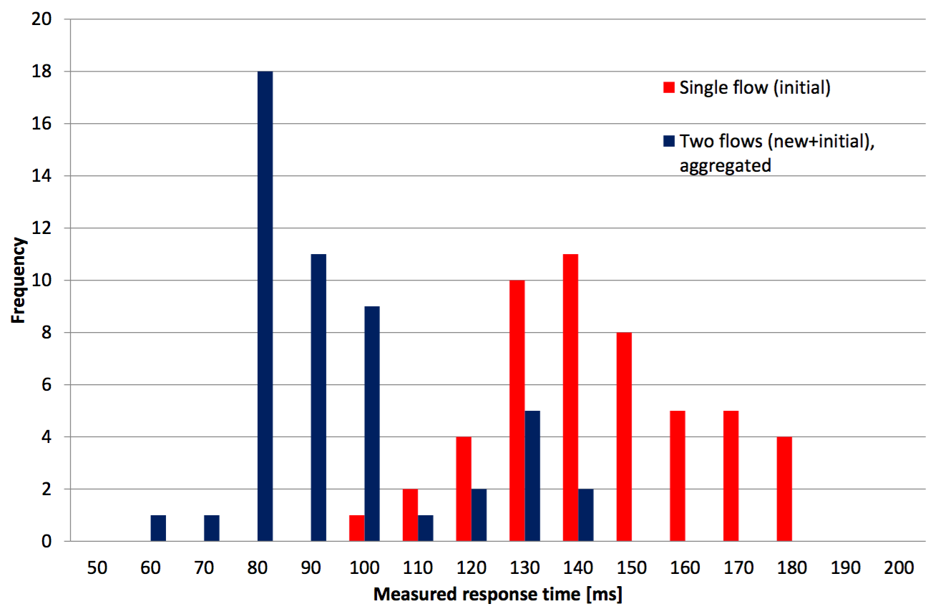
Information Disclosure

Slide 20
Conclusion
OpenFlow has some vulnerabilities on DoS and Information Disclosure attack. We also need to focus on the issue about the security of OpenFlow.

Slide 21
Next Step
Do/Find the comparison the different between SDN structure and traditional network structure.
Can try to use push mechanism to solve the information disclosure

Slide 22
Reference
R. Kloti, et al., “OpenFlow: A Security Analysis,” Proc. Network Protocols (ICNP), 2013 21st IEEE International Conference on, 2013, pp.1-6.
ONF official webpage
Threat Risk Modeling : https://www.owasp.org/index.php/Threat_Risk_Modeling

