Slide 1
Introduction of IoT Agriculture
Crystal

Slide 2
Outline
Traditional Agriculture
Irrigation
Soil Status
Crop Monitoring
Smart Agriculture
Example : Fujitsu
Smart Sweet Persimmon

Slide 3
Traditional Agriculture
Notes:
靠天吃飯，親力親為

Slide 4

Irrigation
air temperature
air humidity
soil temperature
soil moisture
leaf wetness
rainfall

Slide 5
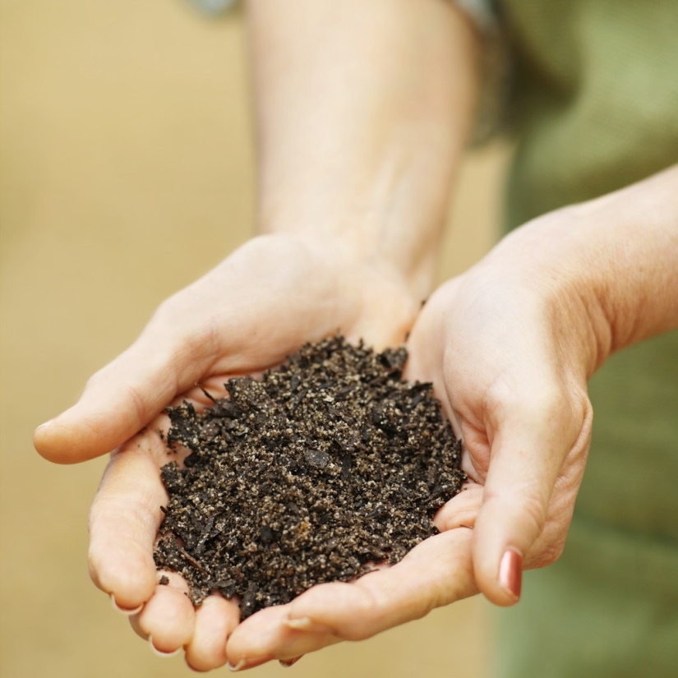
Soil detection
soil pH
soil temperature
soil moisture
trace element

Slide 6
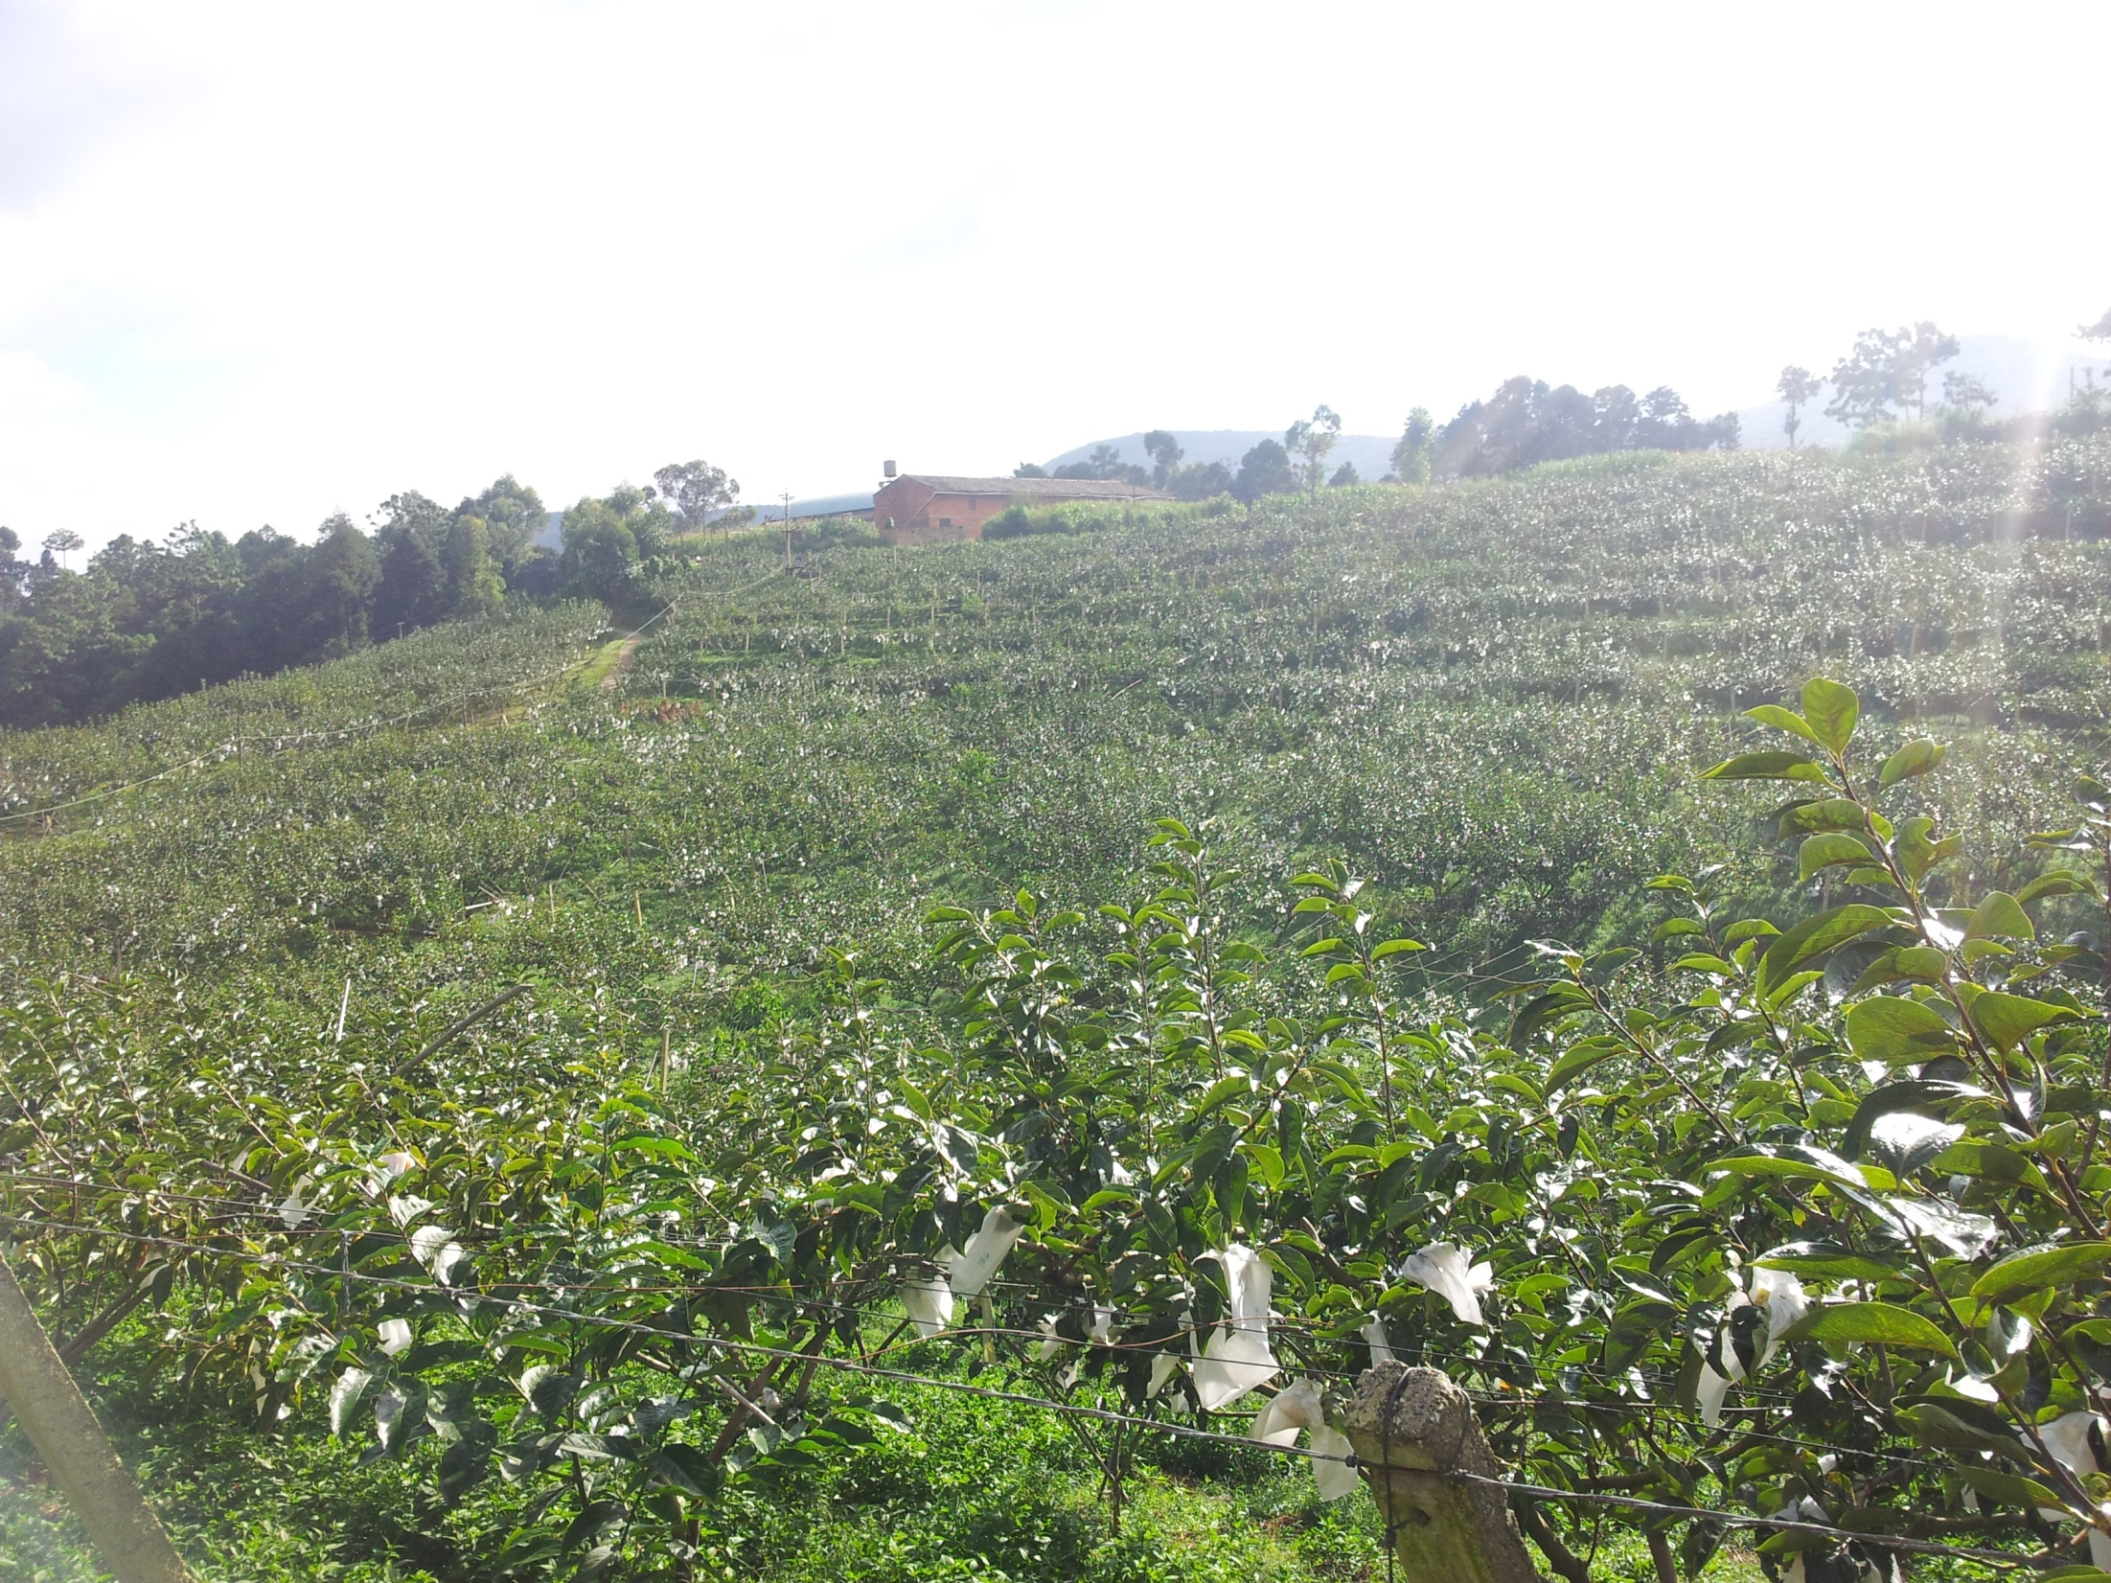
Crop Monitoring

Slide 7
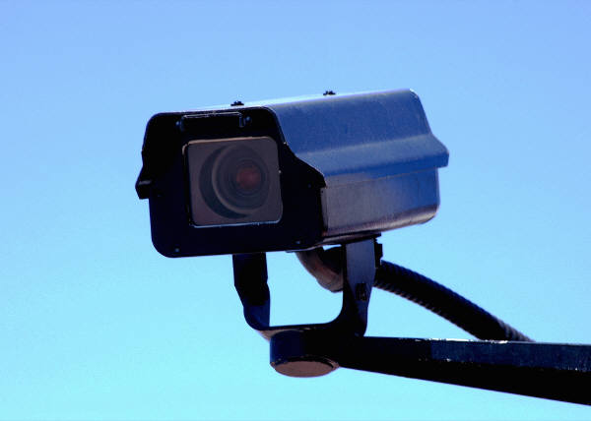
Crop Monitoring
There is one object worthy of being monitor.
That is the thief!

Slide 8
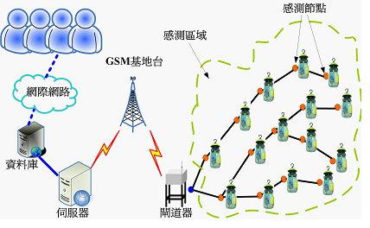
Smart Agriculture

Slide 9
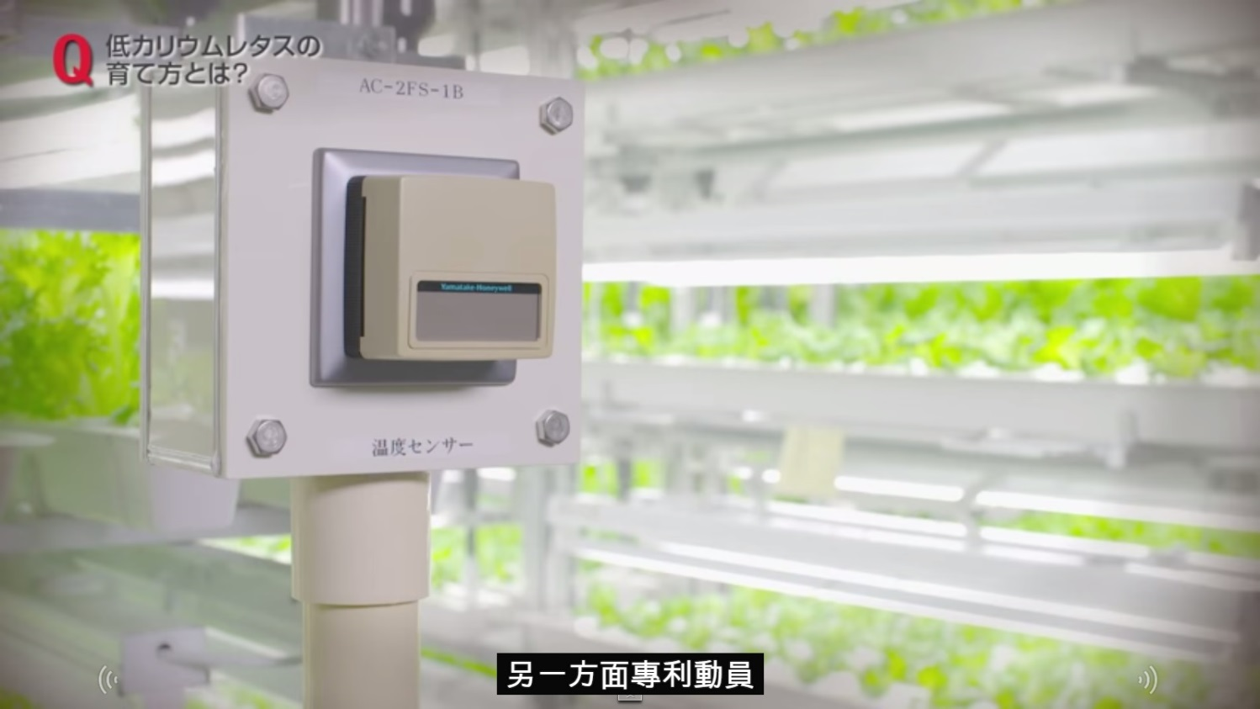
Example
Fujitsu rebuilt their factory to create a whole new world of vegetable.

Slide 10
Smart Sweet Persimmon
Irrigation:
  Dry Season : whether to irrigate or not
  Rainy Season : when will rain
Soil detection:
  Monitor the pH of the soil and trace element
Crop Monitoring:
  Prevent thieves

Slide 11
Reference
http://www.coa.gov.tw/view.php?catid=18014
New Waspmote Sensor Board enables extreme precision agriculture in vineyards and greenhouses
THE INTERNET OF THINGS MEETS HYDROPONICS: HOW TO GROW A BETTER VEGETABLE

