Slide 1
Autonomicity in Virtual Private Network provisioning for enterprises
GLOBECOM Workshops (GC Wkshps), 2010 IEEE

Slide 2
Outline
Introduction
Multiprotocol Label Switching(MPLS)
In-packet Bloom Filter
Multiprotocol Stateless Switching(MPSS)
Autonomic behaviors
Conclusion
Reference

Slide 3
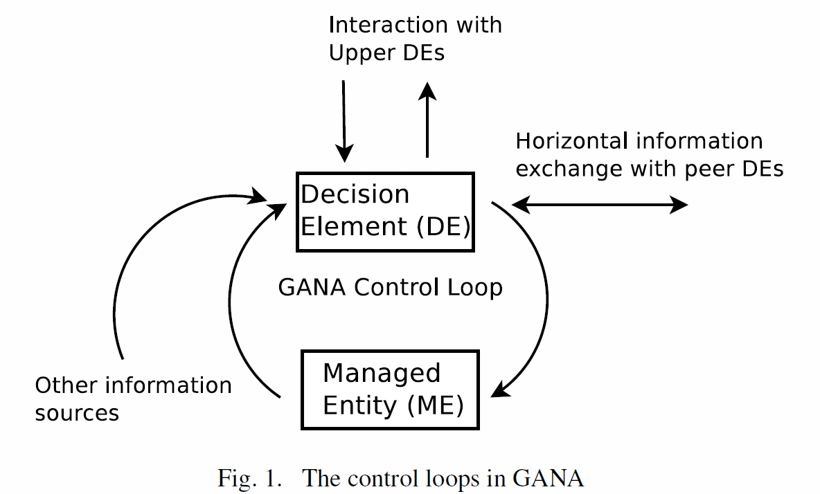
Introduction
For a system to be autonomic, it should have several self-* properties such as self-awareness, self-configuration, self-healing etc.
Generic Autonomic Networking Architecture(GANA)

Slide 4
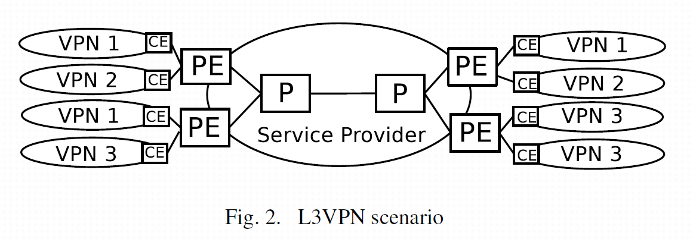
Multiprotocol Label Switching(MPLS)
Customer VPN sites connect with Customer Edge (CE) routers to the Provider Edge (PE) routers. MPLS tunnels are set up between PEs, and operator’s routers (P) forward traffic with MPLS labels.

Slide 5
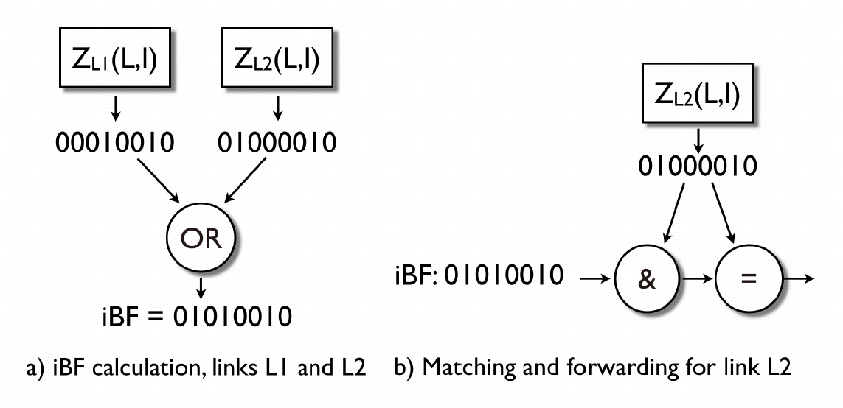
In-packet Bloom Filter
As shown in our prior work, source routes and trees can be efficiently encoded into the packet header using Bloom filters and locally naming links instead of nodes.

Slide 6
Multiprotocol Stateless Switching(MPSS)
MPLS labels are replaced by in-packet Bloom filters
Slightly longer packet headers
Easier (multicast) tree setup than in MPLS
“Stateless” sparse mode multicast
a. MPLS
b. MPSS

Slide 7
Autonomic behaviors
Self-configuration of forwarding table entries
The determined link identifiers are then advertised with a link state routing protocol towards all nodes or to a central entity. The self-configuration of the local ”addresses” and the distribution of them via a routing protocol make it possible to determine and use MPLS-like source routing paths in the network without any additional signalling.
Auto-configuration of VPNs
In the case of a VPN network, this means using a central management system, where authentication of new CEs are performed and the configuration is automatically sent to the PE router.

Slide 8
Autonomic behaviors(cont.)
Resource-aware routing
Traffic Engineering has the task of improving the network’s resource utilization by controlling what paths the traffic takes.
Autonomic provisioning of dynamic multicast trees
If the new receiver is the first in the site joining the group, the multicast tree in the service provider might be changed in the MPLS case, and the iBF must be modified in the MPSS solution

Slide 9
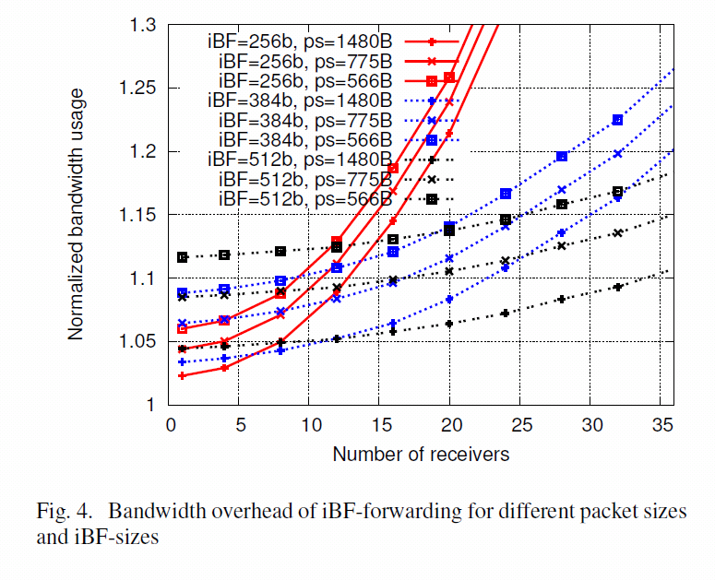
Autonomic behaviors(cont.)
Self-optimization of forwarding performance
The forwarding overhead (the ratio of total sent bytes to the useful traffic, including per-packet overhead) for different Bloom filter sizes can be found for the AS3257 topology (161 nodes, 328 links).

Slide 10
Conclusion
The stateless nature of the in-packet Bloom filter-based forwarding can ease the management of the network, and provides a first step towards autonomicity.
We applied the GANA model to our iBF-based forwarding architecture, and by introducing new Decision Elements, we illustrated autonomic behaviors for optimizing the network usage, by allowing trading-off the per-packet overhead, amount of forwarding state, and bandwidth usage in the network.

Slide 11
Reference
Zahemszky, A. , Jokela, P. and Jokikyyny, T., ”Autonomicity in Virtual Private Network Provisioning for Enterprises”, GLOBECOM Workshops (GC Wkshps), 2010 IEEE
A. Zahemszky, P. Jokela, M. S. S. Ruponen, J. Kempf, and P. Nikander, “MPSS: Multiprotocol stateless switching,” in 13th IEEE Global Internet Symposium, 2010.

