Slide 1
Steganalysis of Audio Based on Audio Quality Metrics
SPIE Electronic Imaging
Ozer, H., Avcibas, I., Sankur, B., Memon,

Slide 2
Outline
Introduction
Method
Results
Conclusion
Reference

Slide 3
Introduction
Distribution of various statistical distance measures, calculated on cover audio signals and on stego-audio signals.
The design of audio steganalyzer relies on the choice of these audio quality measures and the construction of a two-class classifier.

Slide 4
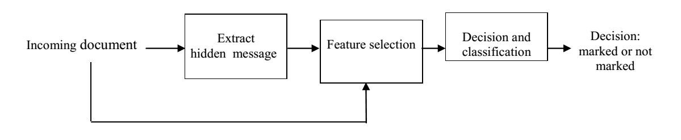
Method
Isolate the stego-signal
Audio quality measures
Feature selection
Classifiers

Slide 5
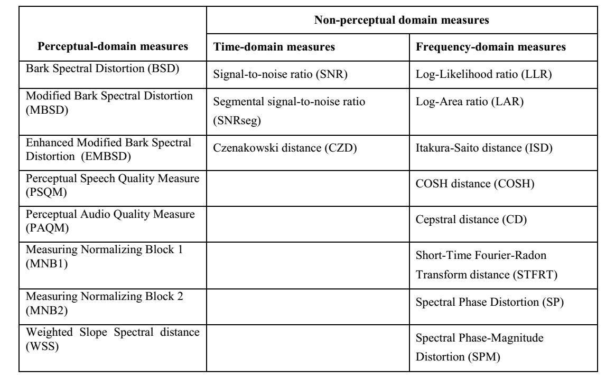
Method
Audio quality measures
  Perceptual
  Non-perceptual

Slide 6
Method
FEATURE SELECTION
  Analysis of Variance (ANOVA)
    The analysis of variance, known as ANOVA, is a general technique for statistical hypothesis testing, often used when an experiment contains a number of groups or conditions, and one wants to see whether there are any statistically significant differences between them.

Slide 7
Method
FEATURE SELECTION
  Sequential Floating Search Method (SFS)
    Choose best two features from the K features, which are those features yielding the best classification result.
    Add the most significant feature from the remaining features set, where selection is made on the basis of the feature that contributes most to the classification result when considered all together.
    Determine the least significant feature from the selected set by conditionally removing features one-by-one check if the removal of the least significant one improves or reduces the classification result, if it improves, remove this feature and go to step 3, else do not remove this feature and go to step 2.
    Stop when the number of selected features equals the number of features required.

Slide 8
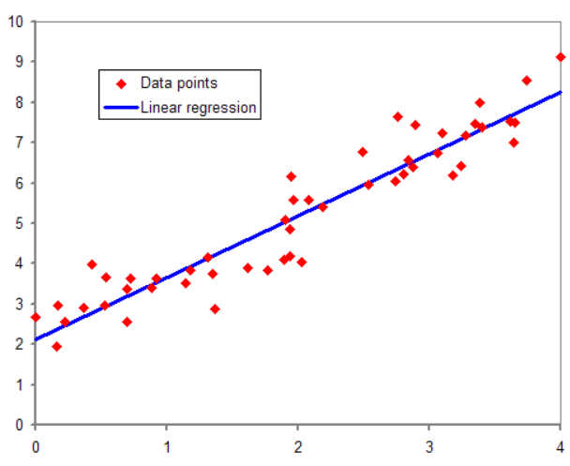
Method
CLASSIFIER DESIGN
  Regression Analysis Classifier

Slide 9
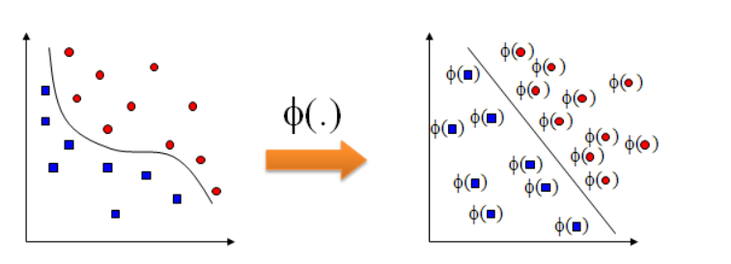
Method
  CLASSIFIER DESIGN
  Support Vector Machine Classifier

Slide 10
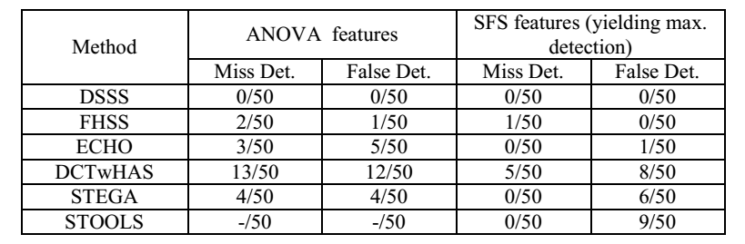
Results
Test results using linear regression classifier for individual methods

Slide 11
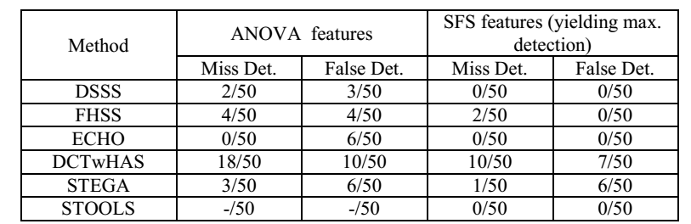
Results
Test results using SVM classifier for individual methods

Slide 12
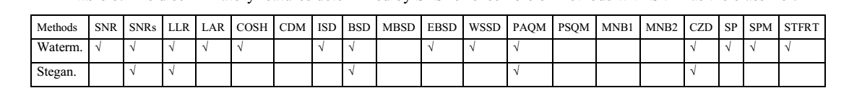
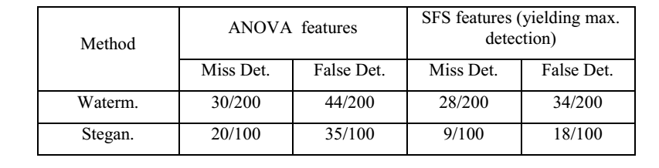
Results
Detection for ensemble

Slide 13
Conclusion
We have comparatively evaluated two classifiers, linear regression and support vector machines. The SFS feature selection coupled with SVM classifier gave the best results.

Slide 14
Reference
Avcıbaş, İ., Memon N., Sankur B., “Steganalysis using image quality metrics”, IEEE Trans. on Image Process., January 2003.
Quackenbush, S. R., T. P. Barnwell III, and M. A. Clements, Objective Measures of Speech Quality, Prentice Hall, Englewood Cliffs, 1988.
Bender, W., D. Gruhl, N. Morimoto, and A. Lu, “Techniques for data hiding”, IBM Systems Journal, vol. 35, no:
3&4, pp. 313-336, 1996.

