Slide 1
Wave Steganography Approach by Modified LSB 2009
Second International Conference on Emerging Trends in Engineering and Technology, ICETET-09
A.J. Umbarkar, A.P. Joshi, A.A. Jadhav ,and A.R. Buchade
Adviser:吳坤熹
Student:陳奕君
Presentation Data:2013/11/5

Slide 2
Outline
Introduction
Related Works
Implementation
Discussion
Reference

Slide 3
Introduction
Three key requirements - namely, imperceptibility of embedding, correct recovery of embedded information, and large payload.
For CD quality sound, it is necessary to encode 16 bits per sample at a rate of 44.1 kHz.
Two techniques – lossless and lossy.

Slide 4
Related Work
Time domain^{1,2}
Wavelet domain³
Fourier domain⁴
Error Correction Coding⁵

Slide 5
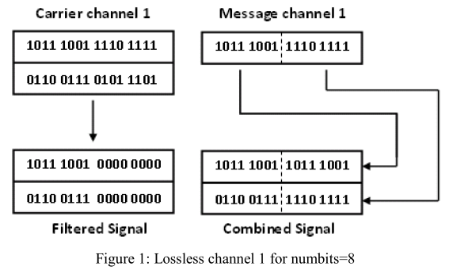
Implementation(1/3)
Message can be hidden in the cover file in two ways:

Slide 6
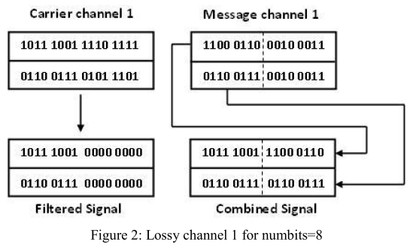
Implementation(2/3)

Slide 7
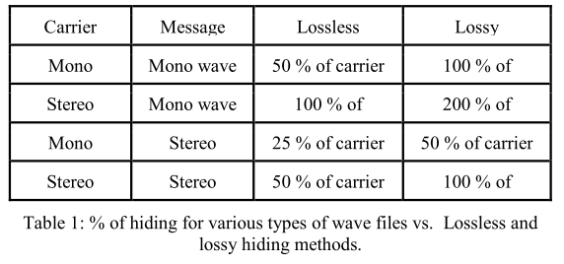
Implementation(3/3)
Lossless hiding:% of hiding = (Carrier bits/ 2 * Message bits) * 100.
Lossy hiding:% of hiding = (Carrier bits / Message bits) * 100.

Slide 8
Discussion
Lossless hiding and lossy hiding.
The proposed methods have high transparency, full recovery and demonstrate correctness of the recovered data.
Future scope for higher level encryption (like DES, AES, RSA etc.)
Scope for hiding even more data hiding by compressing message.
Notes:
DTC (Discrete cosine transform)

Slide 9
Reference
W. Bender, D. Gruhl, N. Morimoto, and A. Lu, "Techniques for data hiding," IBM Systems Journal, vol. 35, issue 3-4, September 1996, pp. 313-336.
N. Cvejic and T. Seppanen, "Channel capacity of high bit rate data hiding algorithms in diverse transform domains”, Proceeding of IEEE international Symposium on Communications and Information Technology (ISCIT 2004), October 2004, vol.1, pp. 84- 88.
N. Taraghi - Delgarm, Speech Watermarking, M.Sc. Thesis, Computer Engineering Department, Sharif University of Technology, Tehran, IRAN, May 2006.
L. Gang, A.N. Akansu, and M. Ramkumar, "MP3 resistant oblivious steganography," Proceedings of 2001 IEEE International Conference on Acoustics, Speech, and Signal Processing (ICASSP'01), May 2001 vol.3, pp. 1365-1368.

Slide 10
Reference
P. Sweene, Error Control Coding (An Introduction), Prentice-Hall International Ltd., Englewood Cliffs, NJ, 1991.

