Slide 1
Design and implementation of server cluster dynamic load balancing based on OpenFlow
2013 International Joint Conference on
Awareness Science and Technology and Ubi-Media Computing (iCAST-UMEDIA),
Author(s):Zhihao Shang , Wenbo Chen ,Qiang Ma ,Bin Wu

Slide 2
Introduction
Currently the network traffic is very large, and grows rapidly, network congestion and server overloading has become a serious problem that we must face.
Traditional load balancer is very expensive (whose price is generally higher than $50k), the policy sets of load balancer needs to be set in advance, flexibility is very low, it cannot deal with emergency situations very well.
If we settle it by abandoning the existing equipment, and purchasing new equipment to upgrade hardware, it will greatly increase the cost and waste resources.

Slide 3
Traditional Load Balancing
First load balancing technology is achieved through DNS(Domain Name System).
Improve the ability of network devices and servers and increase throughput.
It mainly completed the following tasks: solve network congestion problem, provide service nearby.

Slide 4
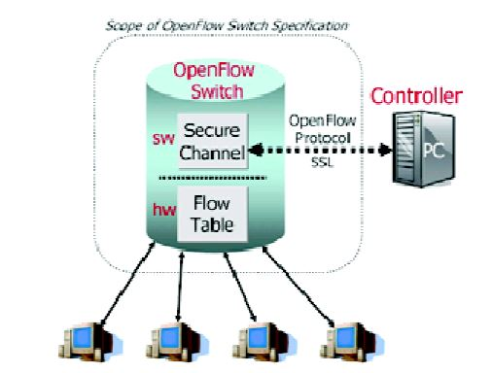
OpenFlow Technology

Slide 5
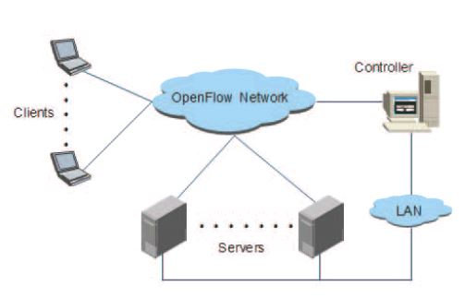
Load Balancing Architecture

Slide 6
Load Balancing Architecture(Cont.)
Random
The Controller randomly selects a server from a list of registered , will handle the request.
Round Robin
The Controller select a server to process the client request according to a certain order.

Slide 7
Load Balancing Architecture(Cont.)
Server-based load balancing(SBLB)
Dynamic feedback the current server load
公式：
L(S_{i}) = r₁ * L(C_{i}) + r₂ * L(M_{i}) + r₃ * L(R_{i}), i = 0, 1, ……., sum r_{i} = 1
L(S_{i}) server; L(C_{i}) mainly collect CPU occupancy rate ; memory occupancy rate; L(R_{i}) response time

Slide 8
Load Balancing Architecture(Cont.)
Server-based load balancing(SBLB)
Processing ability computation of server node
公式：
C(S_{i}) = k₁ * n_{i *} C(C_{i}) + k₂ * C(M_{i}) + k₃ * C(D_{i}) + k₄ * C(N_{i}) + k₅ * C(P_{i}), i = 0, 1, ….., sum(k_{i}) = 1
n_{i} CPU quantity; C(C_{i}) CPU computation ability; C(M_{i}) memory capacity; C(D_{i}) disk I/O rate; C(N_{i}) network throughput; C(P_{i}) process number

Slide 9
Load Balancing Architecture(Cont.)
Server-based load balancing(SBLB)
Calculating weight
公式：
w_{i} = w_{i} + A * ³√ 0.95 – AGGREGATE_{LOADi}
Each new incoming requests
公式：
P(S_{k}) = C(S_{k})/sum C(S_{i})

Slide 10
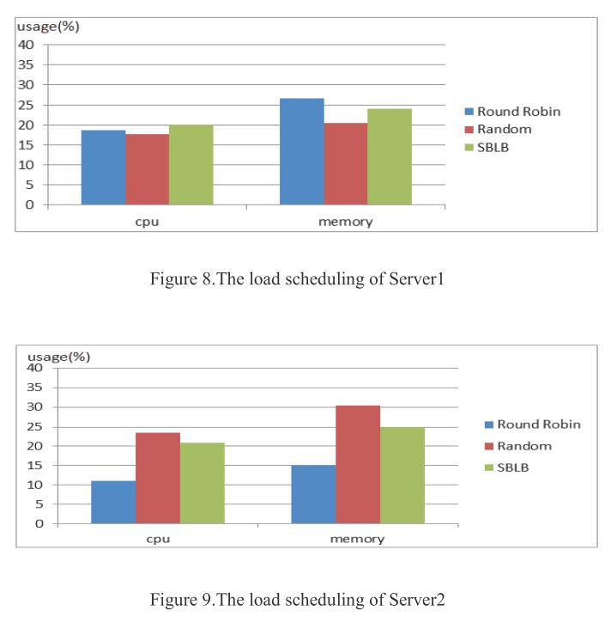
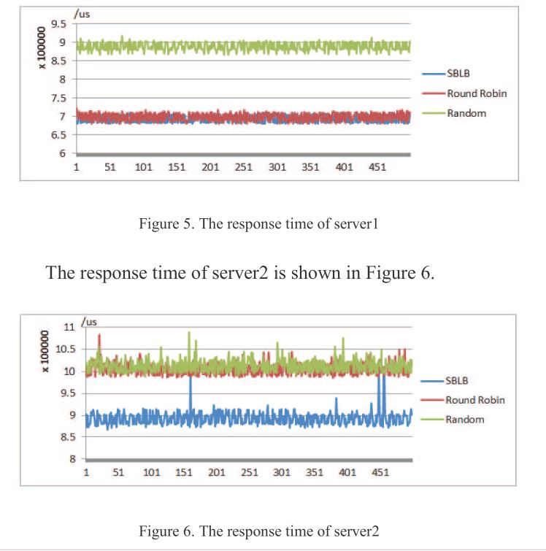
Results of Analysis

Slide 11
Conclusion
Traditional dedicated load balancer faced.(ex: DNS load balancing)
More flexibility and low-cost.
Traditional dedicated hardware load balancer.

