Slide 1
寒假進度報告
Date:2014.02.19
Speaker: Sandra

Slide 2
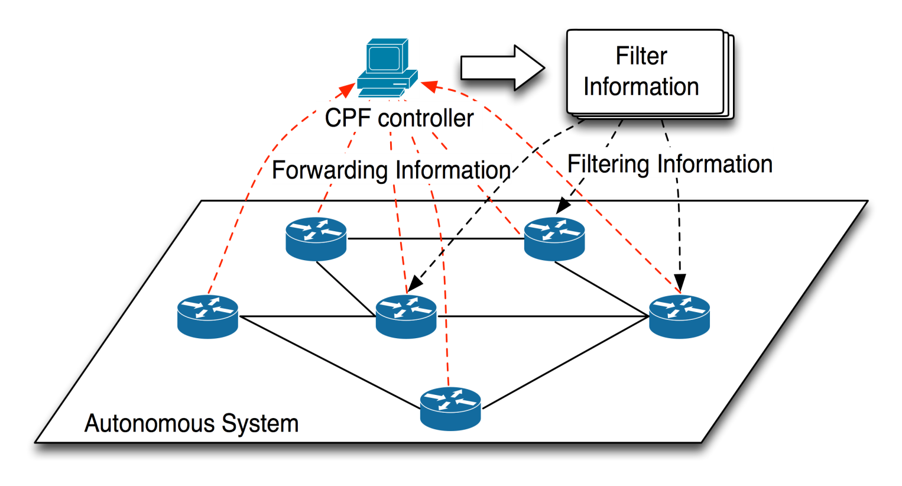
OpenRouter: OpenFlow Extension and Implementation based on a Commercial Router
問題：
Calculated Path Forwarding (CPF):Intra-AS(Autonomous System) and OpenFlow extension.
方法：
FlowTable Extension
FIB and ACL and NetFlow
Control Model Extension
圖片來源：link

Slide 3
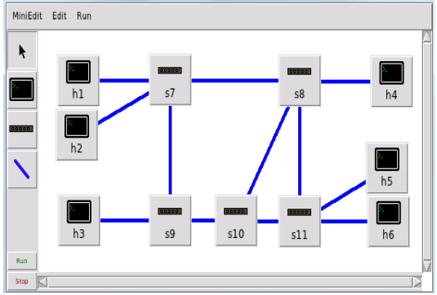
Design and Implementation of Dynamic load balancer on OpenFlow enabled SDNs
問題：
市面上有多很種的負載平衡器都可以達到效果，但為了應對複雜要求網路必須更聰明，能夠控制和管理的設備更好。
方法：
Weighted least connections
Number of active connections (transactions) currently being executed = n
Assigned weighted value of the server = w
Load on the server, x = (Number of active transactions / weight) = n/w
5/3
3/2
4/3
3/1
2/1
5/2

Slide 4
專門替中國人寫的英文課本(初級上)
聽：單字、句子都講得非常清楚。
讀：跟著讀。
寫：每章節後面都有課後練習。
link

